Slide 1


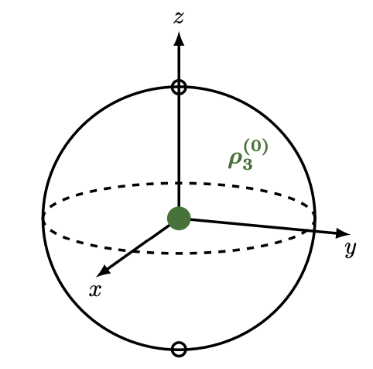
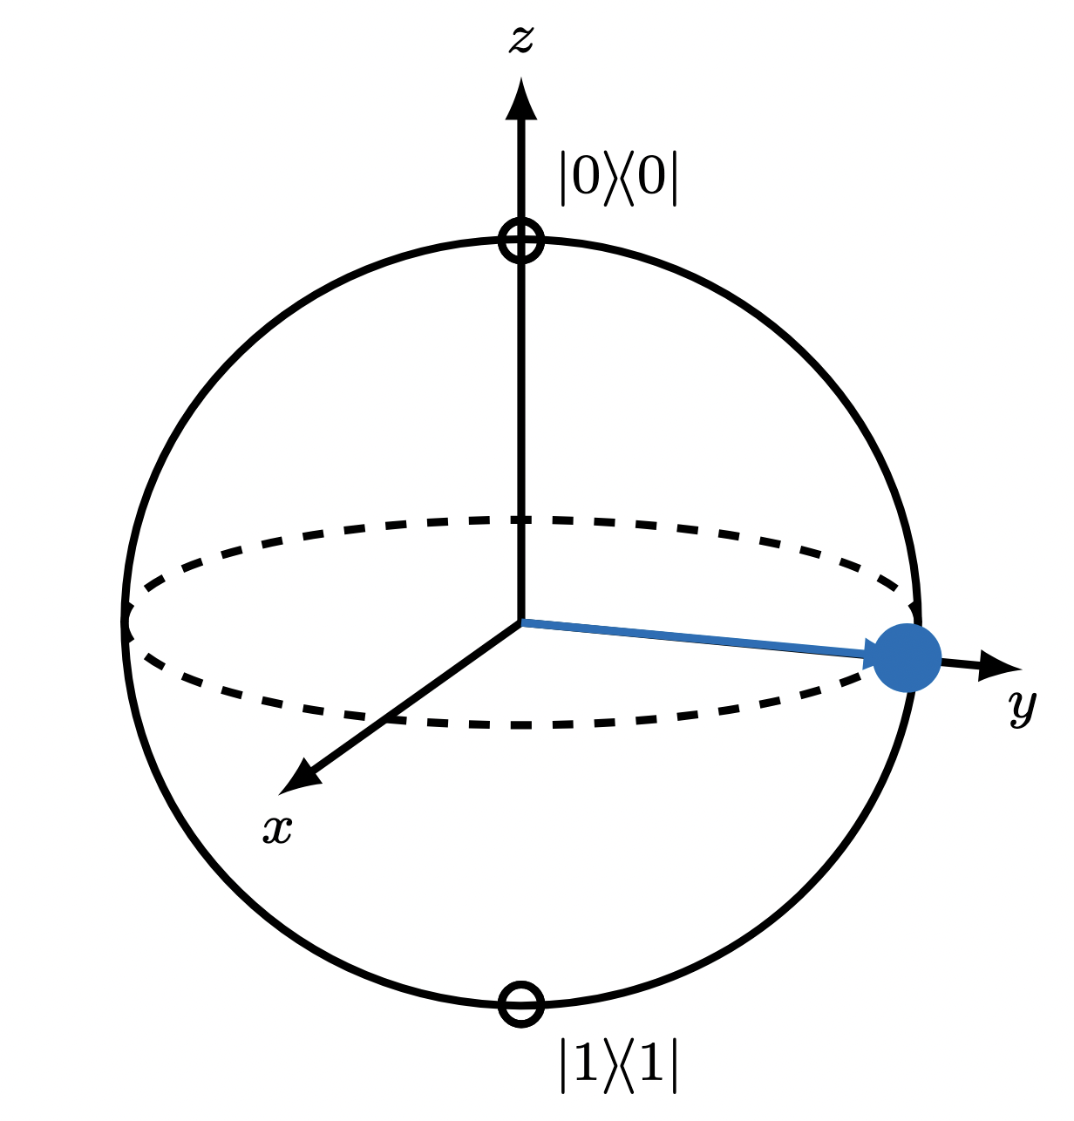
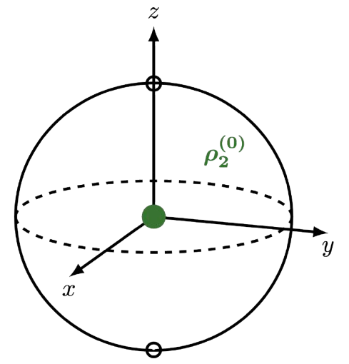
Decoherence, Predictability, and Robustness: Investigating the Preferred Division of a Quantum System into Subsystems
Aiden Karpf
Advised by Prof. Kevin Setter
Pomona College Thesis Presentation 2025

Slide 2
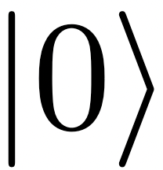
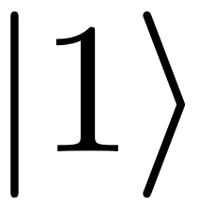
Quantum vs Classical Worlds
electron
1

Slide 3
Quantum vs Classical Worlds
1

Slide 4
Quantum vs Classical Worlds
1

Slide 5
Quantum vs Classical Worlds
1

Slide 6
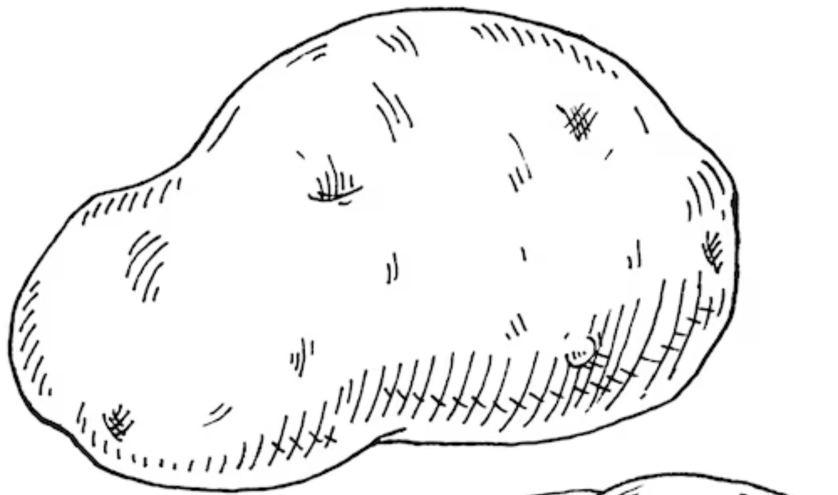
Quantum vs Classical Worlds
potato
1

Slide 7
Quantum vs Classical Worlds
1

Slide 8
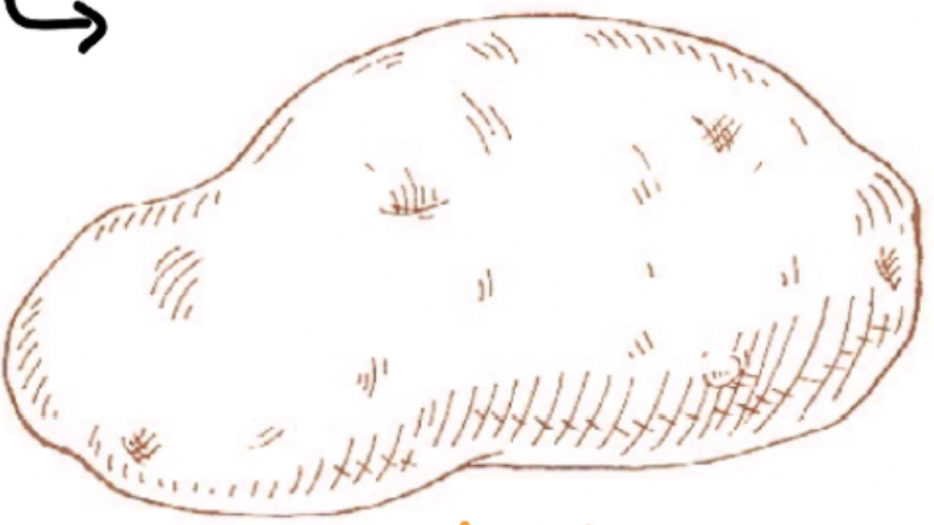
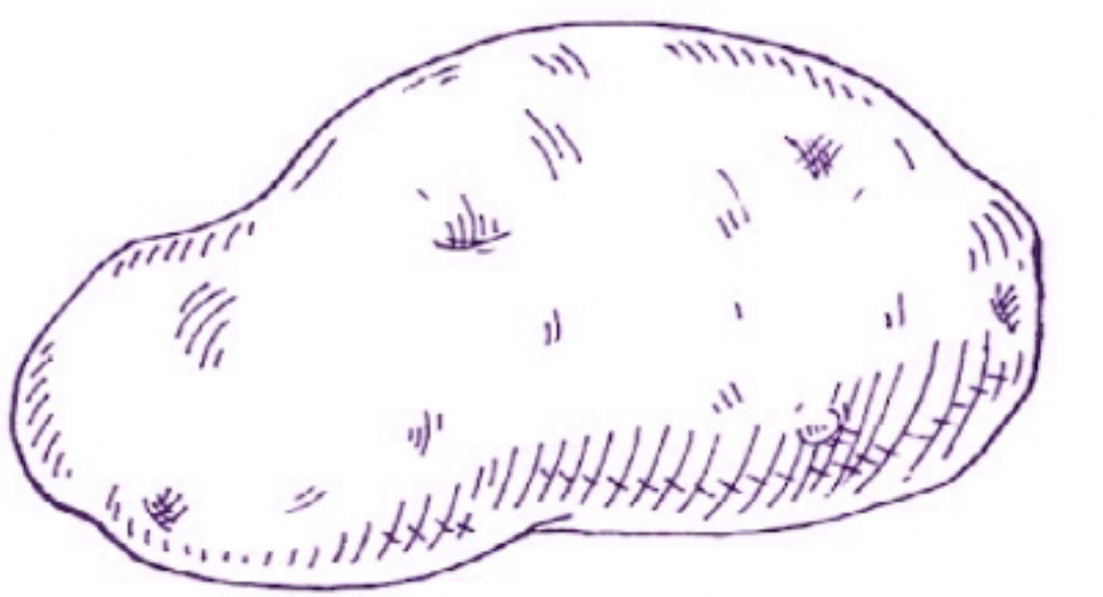
Quantum vs Classical Worlds
1

Slide 9
Quantum vs Classical Worlds
1

Slide 10
Quantum vs Classical Worlds
WHY NOT??
1

Slide 11
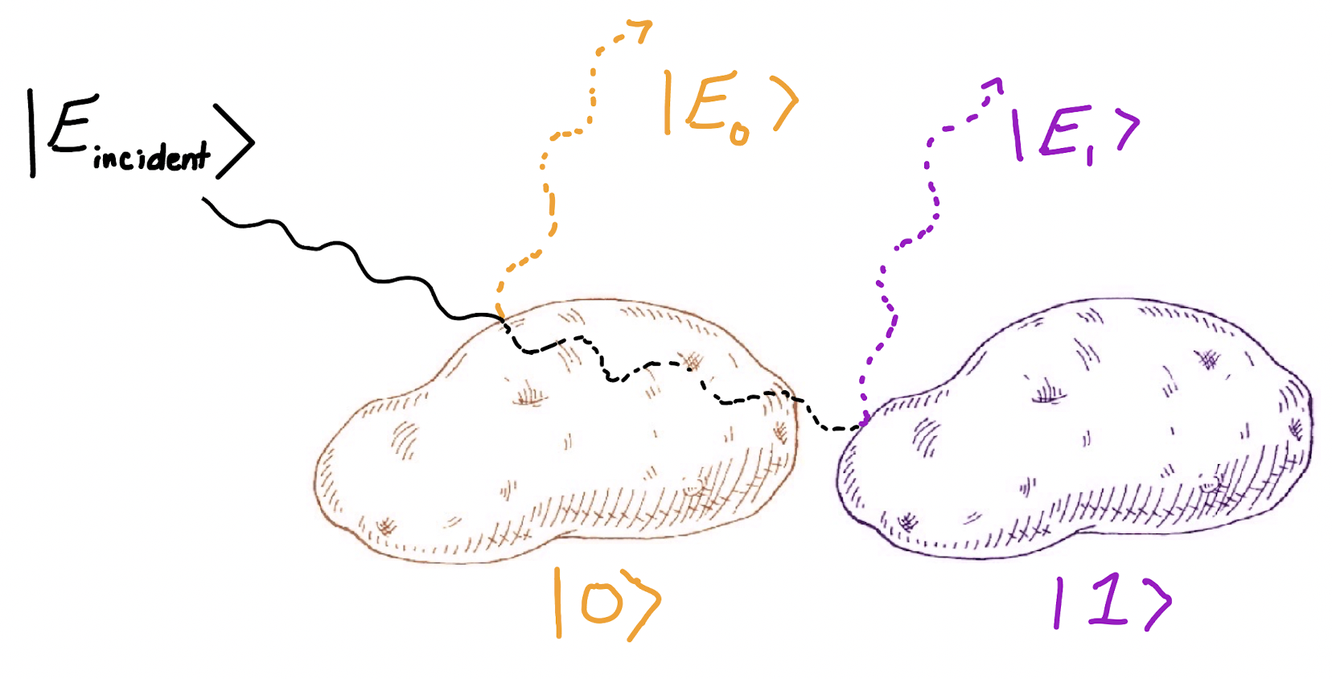
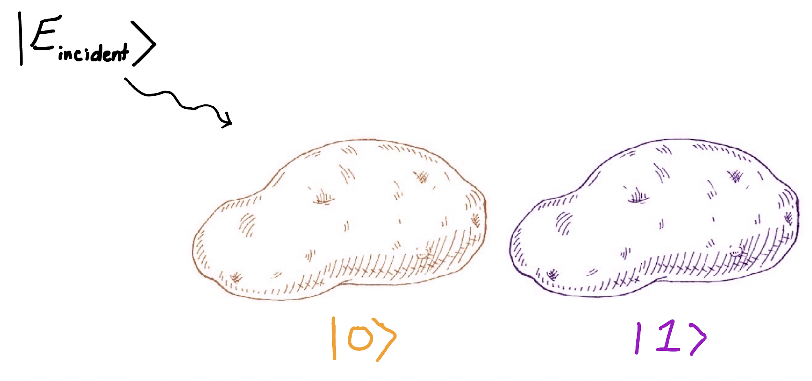
Potato in a Superposition State
time evolution
2
Notes:
– Potato
– We see the potato as in a single position? Why?
– Let’s treat, for example, the potato as a quantum object in a superposition of
position 1 and position 2
- system tensor product environment is what it means to be unentangled

Slide 12
Potato in a Superposition State
Environmental photon
time evolution
2
Notes:
– Potato
– We see the potato as in a single position? Why?
– Let’s treat, for example, the potato as a quantum object in a superposition of
position 1 and position 2
- system tensor product environment is what it means to be unentangled

Slide 13
Potato in a Superposition State
time evolution
2
Notes:
– Potato
– We see the potato as in a single position? Why?
– Let’s treat, for example, the potato as a quantum object in a superposition of
position 1 and position 2
- system tensor product environment is what it means to be unentangled

Slide 14
Potato in a Superposition State
time evolution
2
Notes:
– Potato
– We see the potato as in a single position? Why?
– Let’s treat, for example, the potato as a quantum object in a superposition of
position 1 and position 2
- system tensor product environment is what it means to be unentangled

Slide 15
Potato in a Superposition State
time evolution
2
Notes:
– Potato
– We see the potato as in a single position? Why?
– Let’s treat, for example, the potato as a quantum object in a superposition of
position 1 and position 2
- system tensor product environment is what it means to be unentangled

Slide 16
Potato in a Superposition State
time evolution
2
Notes:
– Potato
– We see the potato as in a single position? Why?
– Let’s treat, for example, the potato as a quantum object in a superposition of
position 1 and position 2
- system tensor product environment is what it means to be unentangled

Slide 17
Potato in a Superposition State
time evolution
2
Notes:
– Potato
– We see the potato as in a single position? Why?
– Let’s treat, for example, the potato as a quantum object in a superposition of
position 1 and position 2
- system tensor product environment is what it means to be unentangled

Slide 18
Potato in a Superposition State
time evolution
Entangled state!
The photon and potato have lost their individuality
The photon is dependent on the potato and vice versa
2
Notes:
– Potato
– We see the potato as in a single position? Why?
– Let’s treat, for example, the potato as a quantum object in a superposition of
position 1 and position 2
- system tensor product environment is what it means to be unentangled

Slide 19
Potato in a Superposition State
time evolution
Entangled state!
The photon and potato have lost their individuality
The photon is dependent on the potato and vice versa
2
Notes:
– Potato
– We see the potato as in a single position? Why?
– Let’s treat, for example, the potato as a quantum object in a superposition of
position 1 and position 2
- system tensor product environment is what it means to be unentangled

Slide 20
Potato in a Superposition State
time evolution
Entangled state!
The photon and potato have lost their individuality
The photon state is dependent on the potato state and vice versa
2
Notes:
– Potato
– We see the potato as in a single position? Why?
– Let’s treat, for example, the potato as a quantum object in a superposition of
position 1 and position 2
- system tensor product environment is what it means to be unentangled

Slide 21
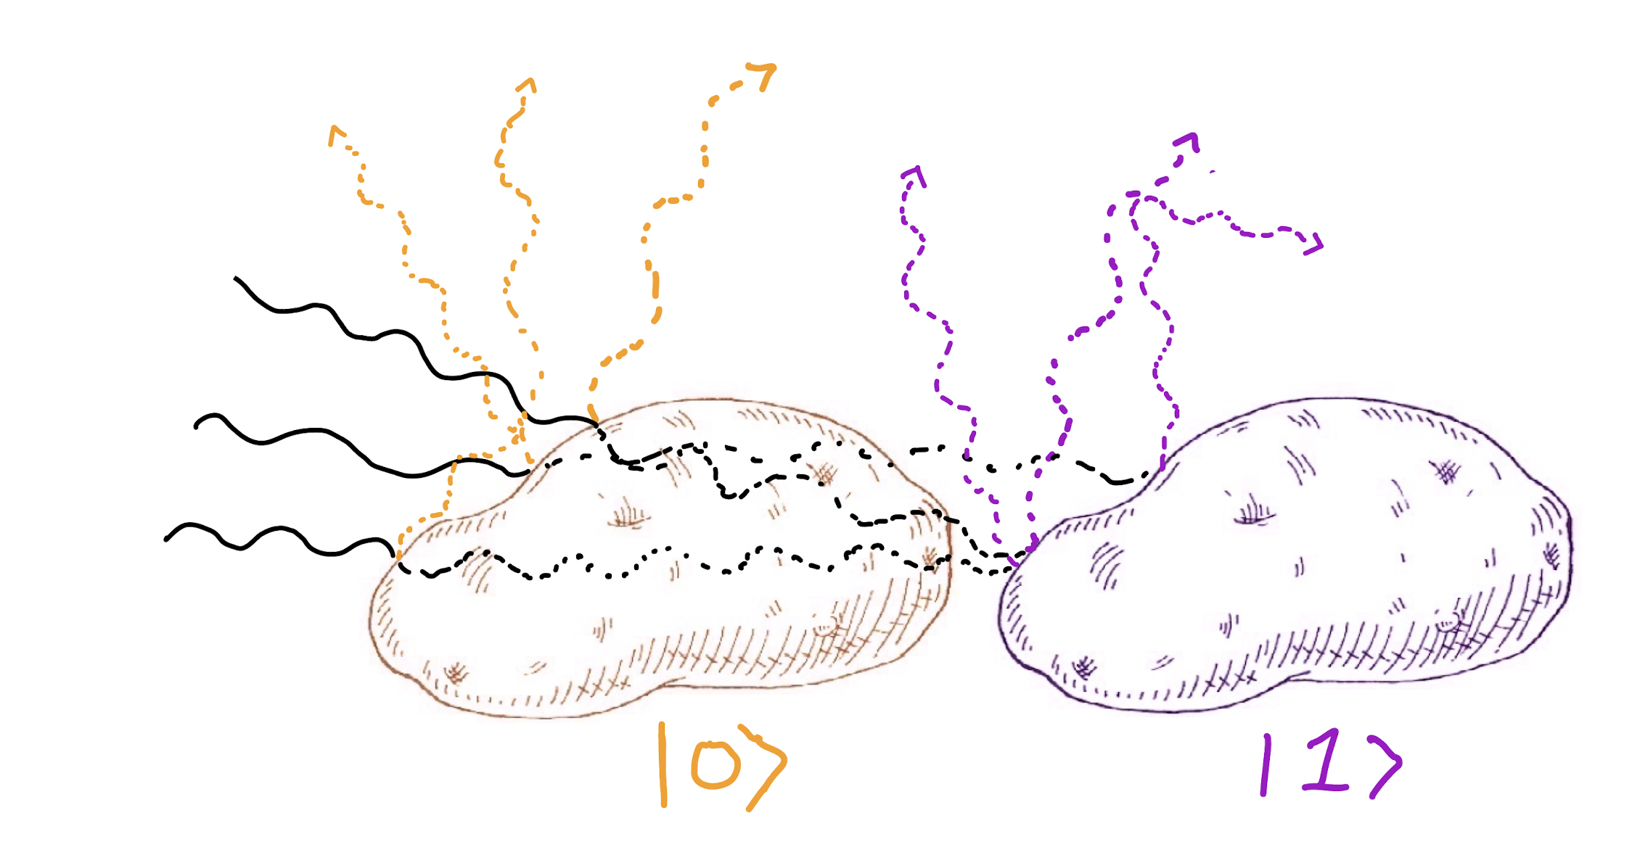
Decoherence to a Pointer State
Superposition state:
time evolution
3
Notes:
– Potato
– We see the potato as in a single position? Why?
– Let’s treat, for example, the potato as a quantum object in a superposition of
position 1 and position 2
- system tensor product environment is what it means to be unentangled

Slide 22
Decoherence to a Pointer State
*rapid entanglement growth*
Superposition state:
time evolution
3
Notes:
– Potato
– We see the potato as in a single position? Why?
– Let’s treat, for example, the potato as a quantum object in a superposition of
position 1 and position 2
- system tensor product environment is what it means to be unentangled

Slide 23
Decoherence to a Pointer State
*rapid entanglement growth*
Superposition state:
time evolution
Decoherence
3
Notes:
– Potato
– We see the potato as in a single position? Why?
– Let’s treat, for example, the potato as a quantum object in a superposition of
position 1 and position 2
- system tensor product environment is what it means to be unentangled

Slide 24
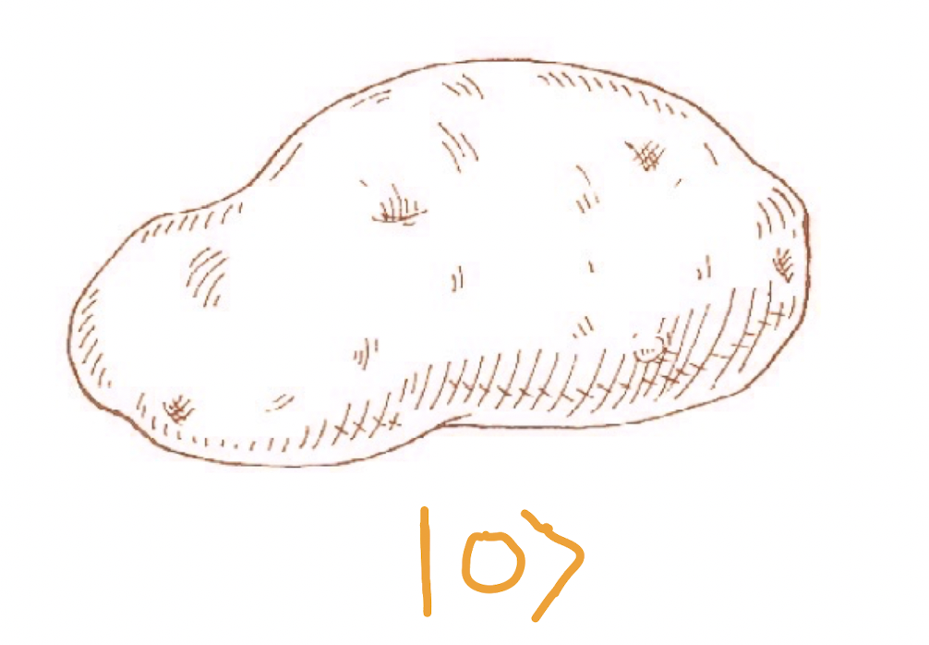
Decoherence to a Pointer State
*rapid entanglement growth*
Superposition state:
time evolution
Decoherence
3
Notes:
– Potato
– We see the potato as in a single position? Why?
– Let’s treat, for example, the potato as a quantum object in a superposition of
position 1 and position 2
- system tensor product environment is what it means to be unentangled

Slide 25
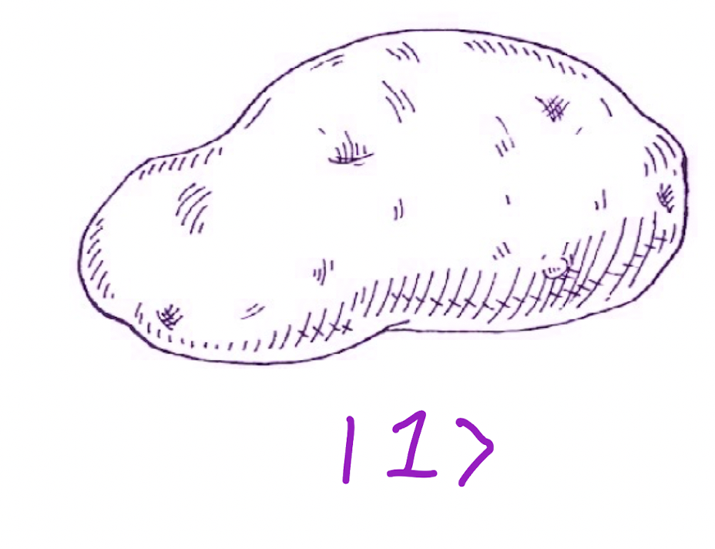

Decoherence to a Pointer State
*rapid entanglement growth*
Superposition state:
time evolution
Decoherence
3
Notes:
– Potato
– We see the potato as in a single position? Why?
– Let’s treat, for example, the potato as a quantum object in a superposition of
position 1 and position 2
- system tensor product environment is what it means to be unentangled

Slide 26
Decoherence to a Pointer State
*rapid entanglement growth*
Superposition state:
time evolution
Decoherence
Pointer states:
3
Notes:
– Potato
– We see the potato as in a single position? Why?
– Let’s treat, for example, the potato as a quantum object in a superposition of
position 1 and position 2
- system tensor product environment is what it means to be unentangled

Slide 27
Decoherence to a Pointer State
*rapid entanglement growth*
Superposition state:
time evolution
Decoherence is why potatoes don’t enter superpositions!
Decoherence
Pointer states:
3
Notes:
– Potato
– We see the potato as in a single position? Why?
– Let’s treat, for example, the potato as a quantum object in a superposition of
position 1 and position 2
- system tensor product environment is what it means to be unentangled

Slide 28
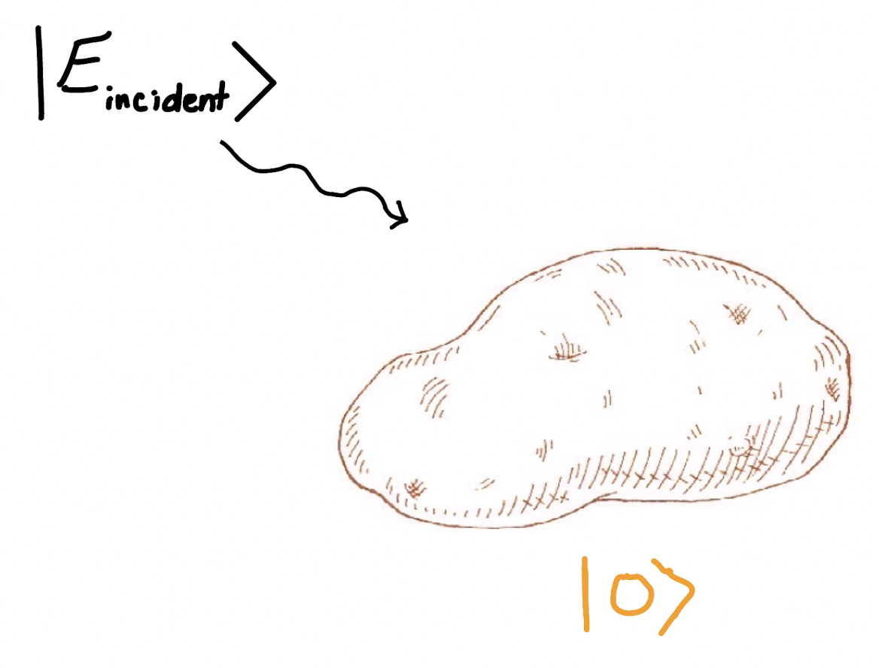
Potato Initialized in a Pointer State
4
Notes:
– Potato
– We see the potato as in a single position? Why?
– Let’s treat, for example, the potato as a quantum object in a superposition of
position 1 and position 2
- system tensor product environment is what it means to be unentangled

Slide 29
Potato Initialized in a Pointer State
4
Notes:
– Potato
– We see the potato as in a single position? Why?
– Let’s treat, for example, the potato as a quantum object in a superposition of
position 1 and position 2
- system tensor product environment is what it means to be unentangled

Slide 30
Potato Initialized in a Pointer State
time evolution
4
Notes:
– Potato
– We see the potato as in a single position? Why?
– Let’s treat, for example, the potato as a quantum object in a superposition of
position 1 and position 2
- system tensor product environment is what it means to be unentangled

Slide 31
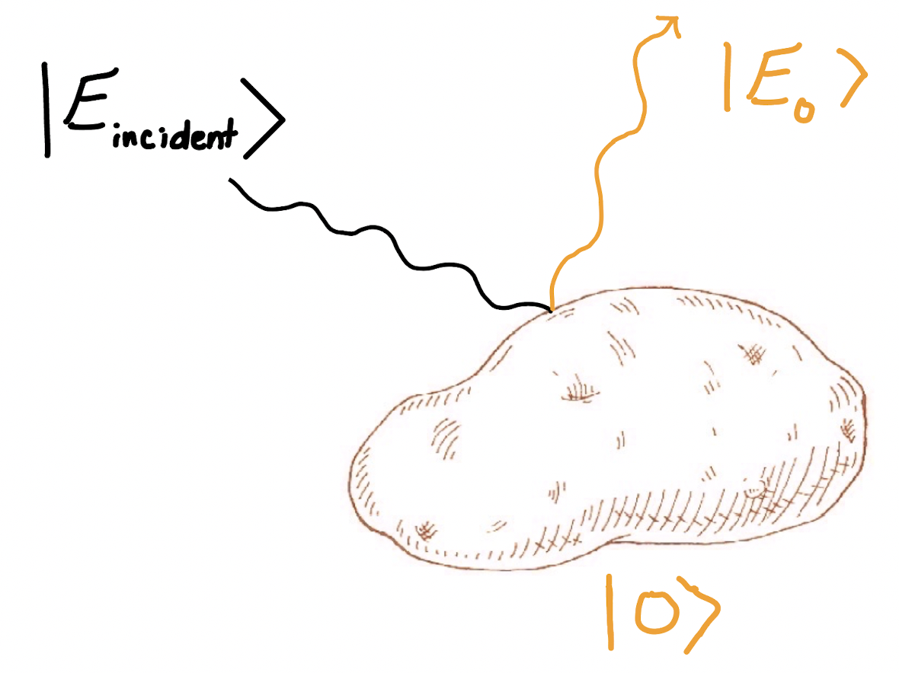
Potato Initialized in a Pointer State
time evolution
4
Notes:
– Potato
– We see the potato as in a single position? Why?
– Let’s treat, for example, the potato as a quantum object in a superposition of
position 1 and position 2
- system tensor product environment is what it means to be unentangled

Slide 32
Potato Initialized in a Pointer State
time evolution
Unentangled state!
4
Notes:
– Potato
– We see the potato as in a single position? Why?
– Let’s treat, for example, the potato as a quantum object in a superposition of
position 1 and position 2
- system tensor product environment is what it means to be unentangled

Slide 33
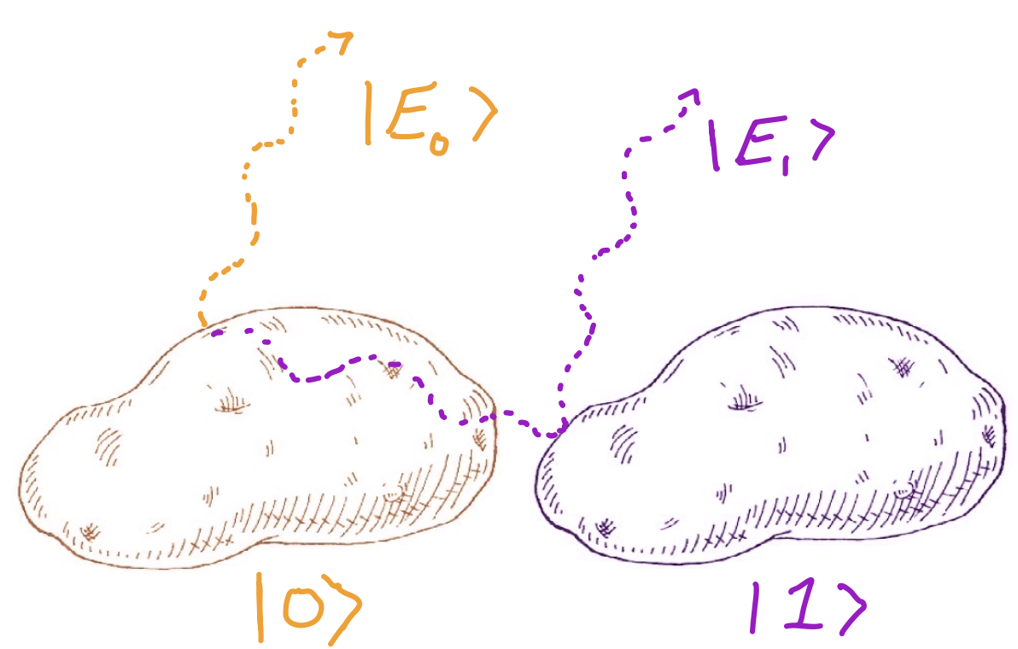
Focus of Thesis:
The division of a composite quantum system into subsystems.
Sometimes our subsystems are not as clear as “potato” and “photon”
Question:
How do we determine these subsystems given an abstract quantum system?
5
Notes:
– Potato
– We see the potato as in a single position? Why?
– Let’s treat, for example, the potato as a quantum object in a superposition of
position 1 and position 2
- system tensor product environment is what it means to be unentangled

Slide 34
The Bloch Ball: A Visualization Tool
6
Notes:
– Potato
– We see the potato as in a single position? Why?
– Let’s treat, for example, the potato as a quantum object in a superposition of
position 1 and position 2
- system tensor product environment is what it means to be unentangled

Slide 35
The Bloch Ball: A Visualization Tool
Bloch Ball with blue state represents our “system” (e.g., potato)
6
Notes:
– Potato
– We see the potato as in a single position? Why?
– Let’s treat, for example, the potato as a quantum object in a superposition of
position 1 and position 2
- system tensor product environment is what it means to be unentangled

Slide 36
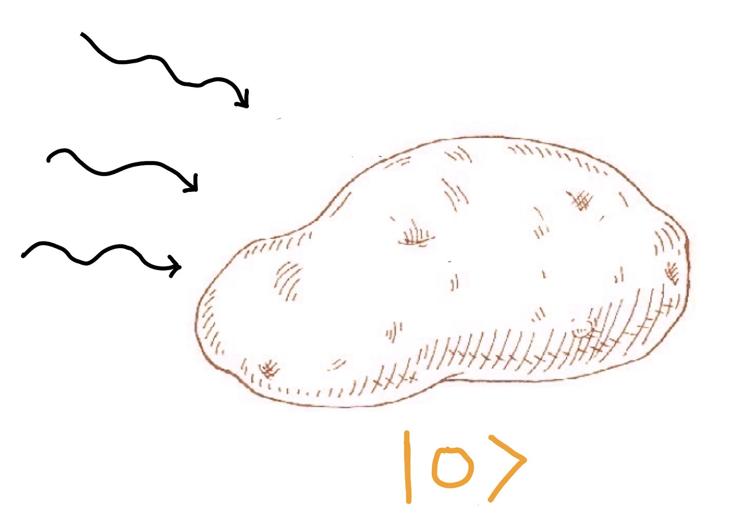
The Bloch Ball: A Visualization Tool
KEY:
Poles = basis states
Surface = unentangled state
Interior = entangled state
6
Notes:
– Potato
– We see the potato as in a single position? Why?
– Let’s treat, for example, the potato as a quantum object in a superposition of
position 1 and position 2
- system tensor product environment is what it means to be unentangled

Slide 37
The Bloch Ball: A Visualization Tool
KEY:
Poles = basis states
Surface = unentangled state
Interior = entangled state
6
Notes:
– Potato
– We see the potato as in a single position? Why?
– Let’s treat, for example, the potato as a quantum object in a superposition of
position 1 and position 2
- system tensor product environment is what it means to be unentangled

Slide 38
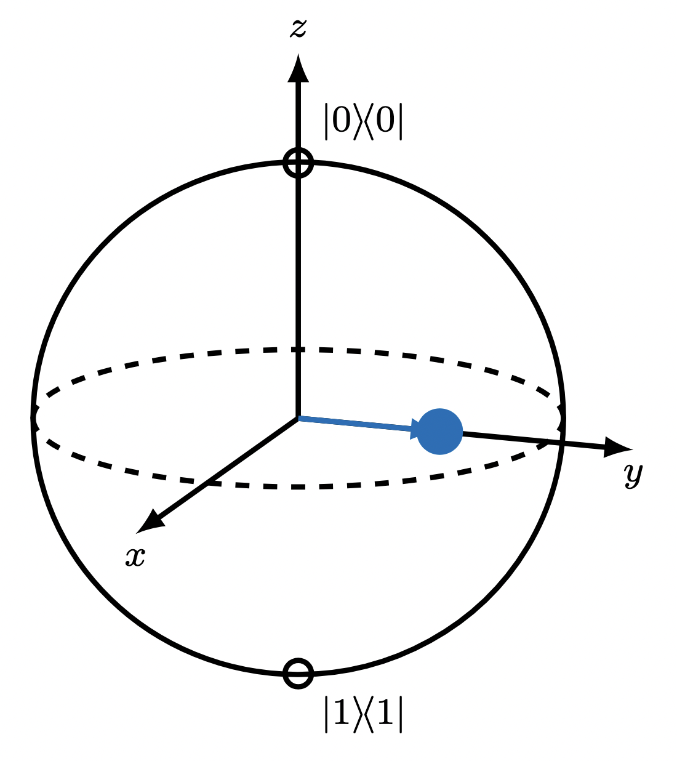
The Bloch Ball: A Visualization Tool
KEY:
Poles = basis states
Surface = unentangled state
Interior = entangled state
6
Notes:
– Potato
– We see the potato as in a single position? Why?
– Let’s treat, for example, the potato as a quantum object in a superposition of
position 1 and position 2
- system tensor product environment is what it means to be unentangled

Slide 39
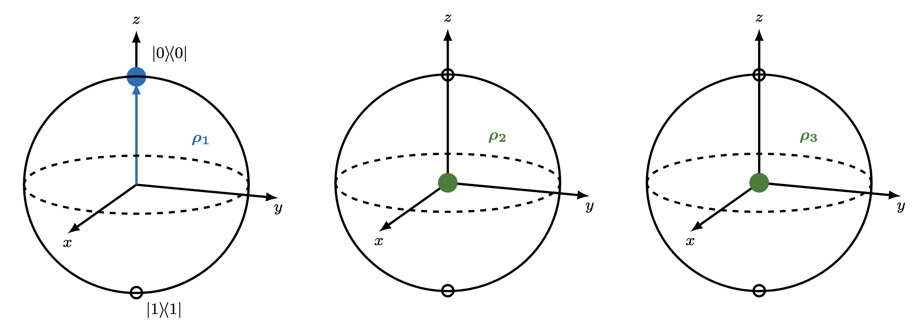
Tensor Product Structures
7
Notes:
– Potato
– We see the potato as in a single position? Why?
– Let’s treat, for example, the potato as a quantum object in a superposition of
position 1 and position 2
- system tensor product environment is what it means to be unentangled

Slide 40

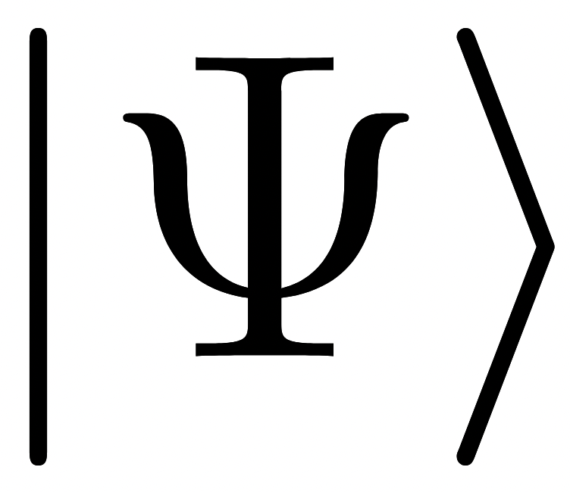
Tensor Product Structures
7
Notes:
– Potato
– We see the potato as in a single position? Why?
– Let’s treat, for example, the potato as a quantum object in a superposition of
position 1 and position 2
- system tensor product environment is what it means to be unentangled

Slide 41
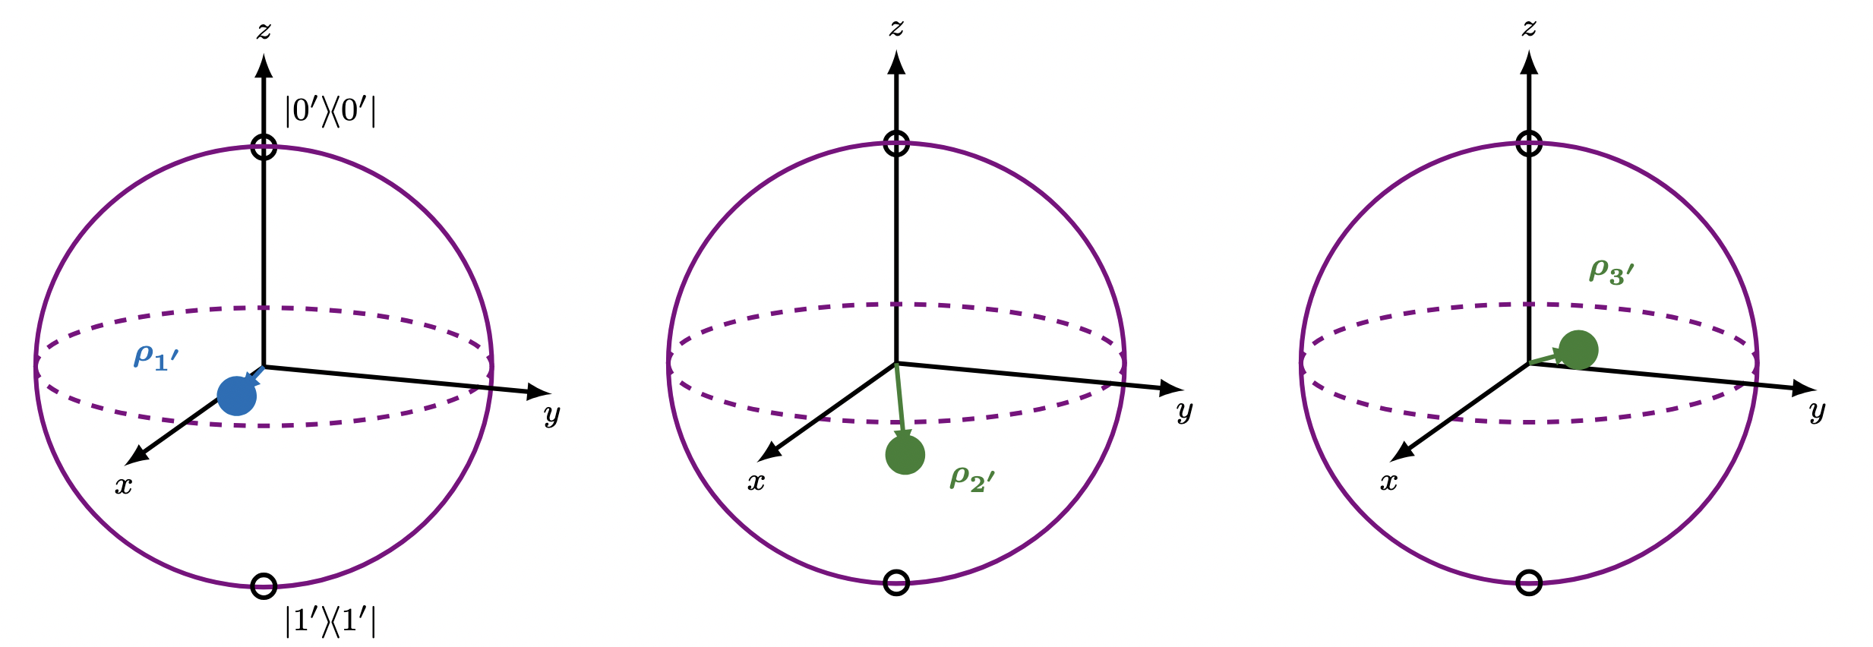
Tensor Product Structures
7
Notes:
– Potato
– We see the potato as in a single position? Why?
– Let’s treat, for example, the potato as a quantum object in a superposition of
position 1 and position 2
- system tensor product environment is what it means to be unentangled

Slide 42
Tensor Product Structures
7
Notes:
– Potato
– We see the potato as in a single position? Why?
– Let’s treat, for example, the potato as a quantum object in a superposition of
position 1 and position 2
- system tensor product environment is what it means to be unentangled

Slide 43
Tensor Product Structures
Tensor Product Structure 1 (Qubits 1, 2, 3):
Tensor Product Structure 2 (Qubits 1′ , 2′, 3′):
7
Notes:
– Potato
– We see the potato as in a single position? Why?
– Let’s treat, for example, the potato as a quantum object in a superposition of
position 1 and position 2
- system tensor product environment is what it means to be unentangled

Slide 44
Tensor Product Structures
Tensor Product Structure 1 (Qubits 1, 2, 3):
Entanglement is a Relative Concept!
Tensor Product Structure 2 (Qubits 1′ , 2′, 3′):
7
Notes:
– Potato
– We see the potato as in a single position? Why?
– Let’s treat, for example, the potato as a quantum object in a superposition of
position 1 and position 2
- system tensor product environment is what it means to be unentangled

Slide 45
Tensor Product Structures
Tensor Product Structure 1 (Qubits 1, 2, 3):
Entanglement is a Relative Concept!
Tensor Product Structure 2 (Qubits 1′ , 2′, 3′):
7
Notes:
– Potato
– We see the potato as in a single position? Why?
– Let’s treat, for example, the potato as a quantum object in a superposition of
position 1 and position 2
- system tensor product environment is what it means to be unentangled

Slide 46
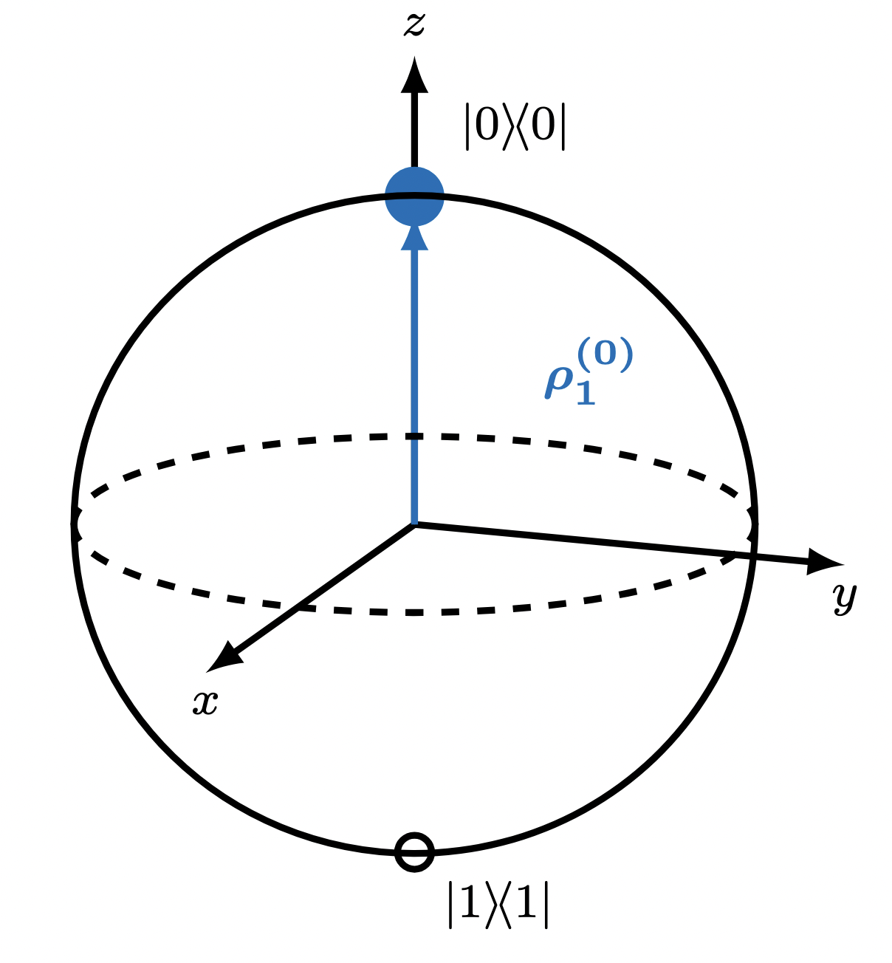
Quasi-classical Tensor Product Structure (qcTPS)
8
Notes:
– Potato
– We see the potato as in a single position? Why?
– Let’s treat, for example, the potato as a quantum object in a superposition of
position 1 and position 2
- system tensor product environment is what it means to be unentangled

Slide 47
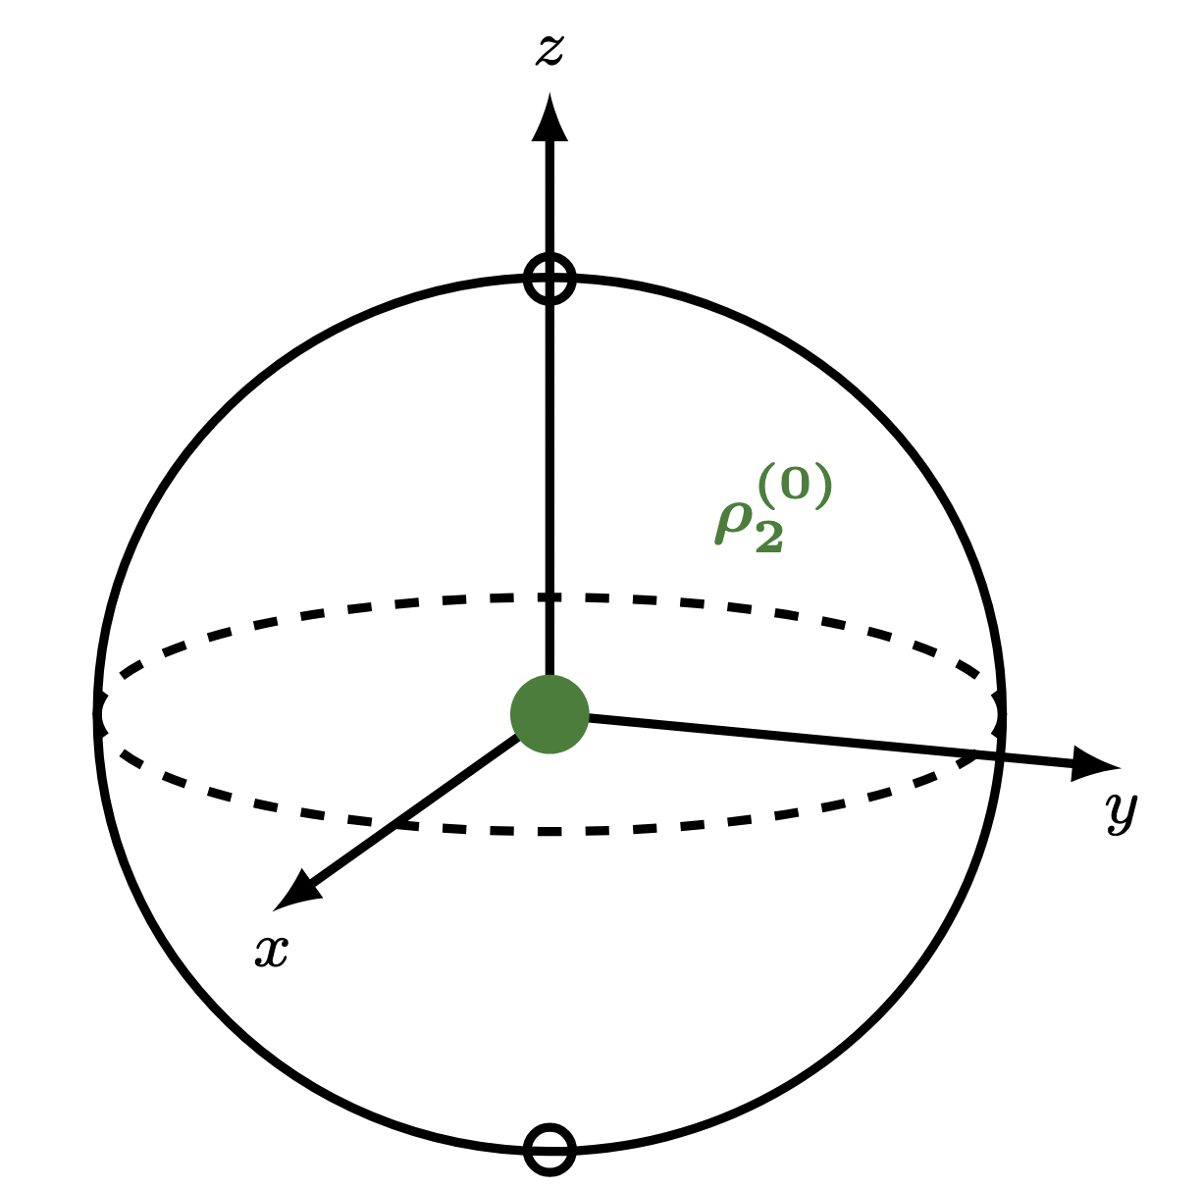
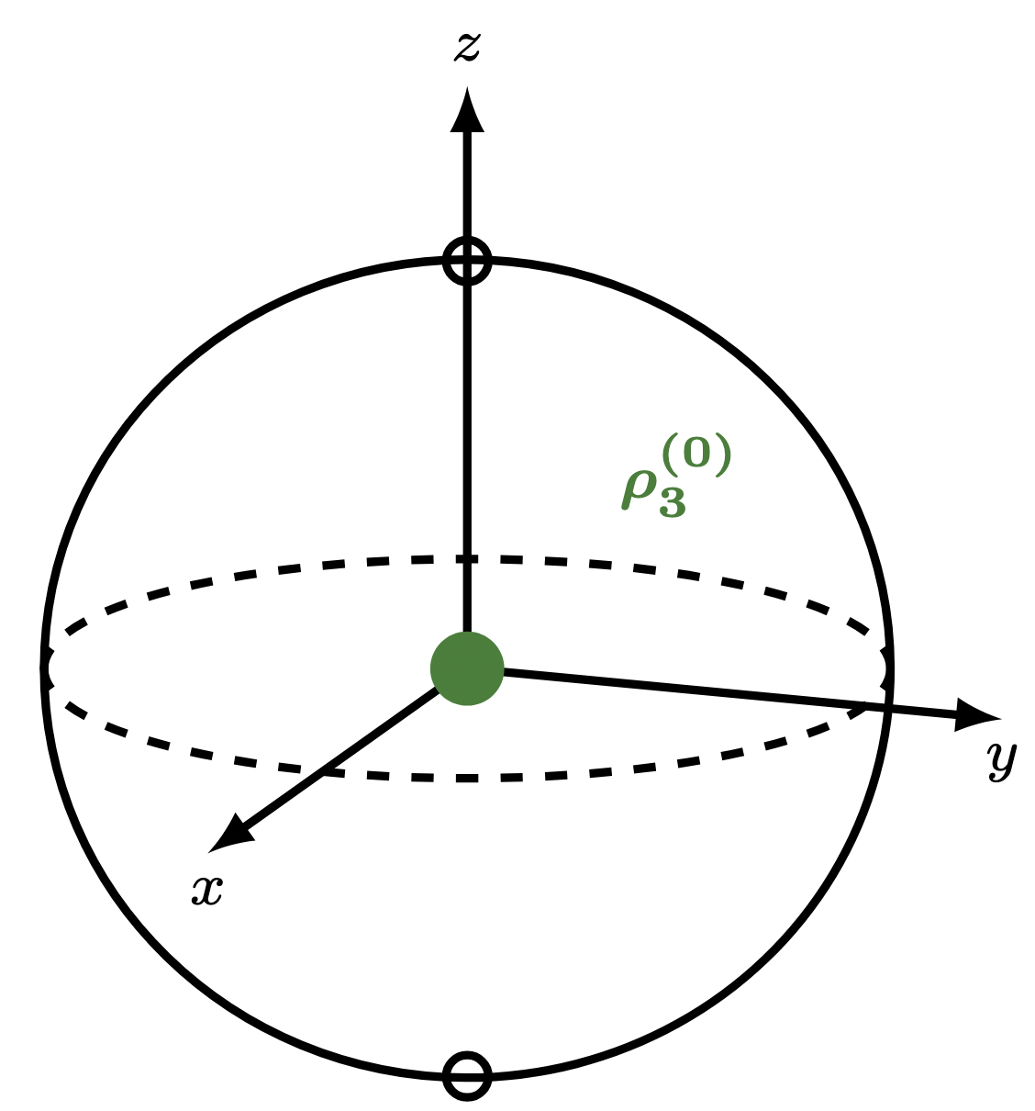
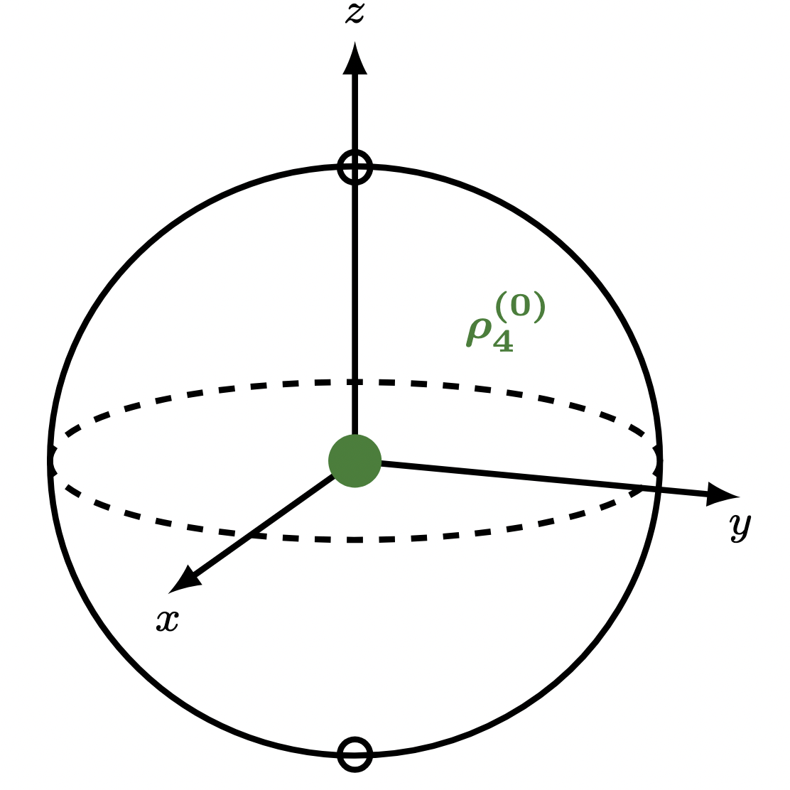
Quasi-classical Tensor Product Structure (qcTPS)
8
Notes:
– Potato
– We see the potato as in a single position? Why?
– Let’s treat, for example, the potato as a quantum object in a superposition of
position 1 and position 2
- system tensor product environment is what it means to be unentangled

Slide 48
Quasi-classical Tensor Product Structure (qcTPS)
time evolution
8
Notes:
– Potato
– We see the potato as in a single position? Why?
– Let’s treat, for example, the potato as a quantum object in a superposition of
position 1 and position 2
- system tensor product environment is what it means to be unentangled

Slide 49
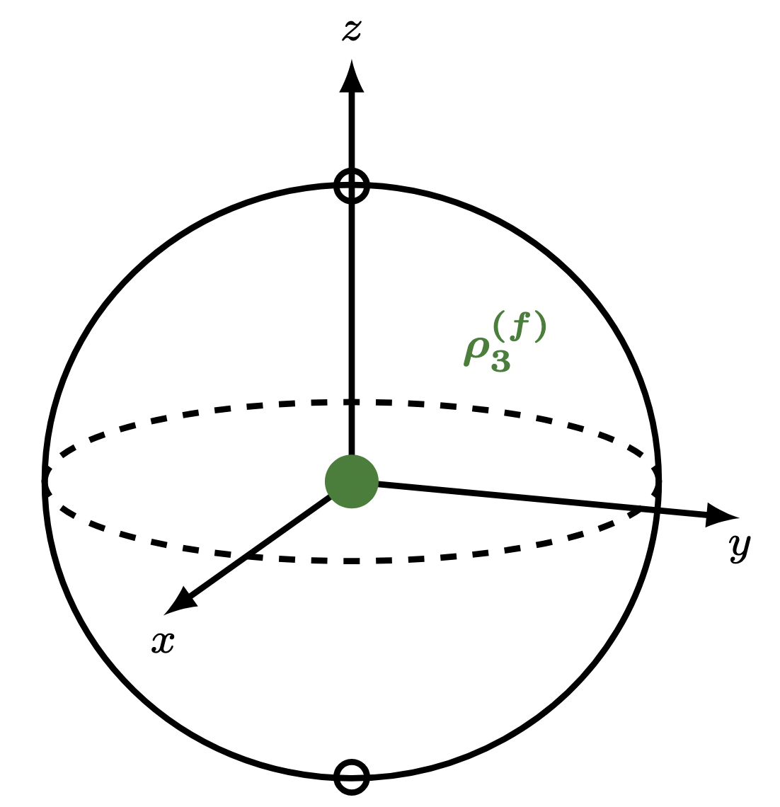
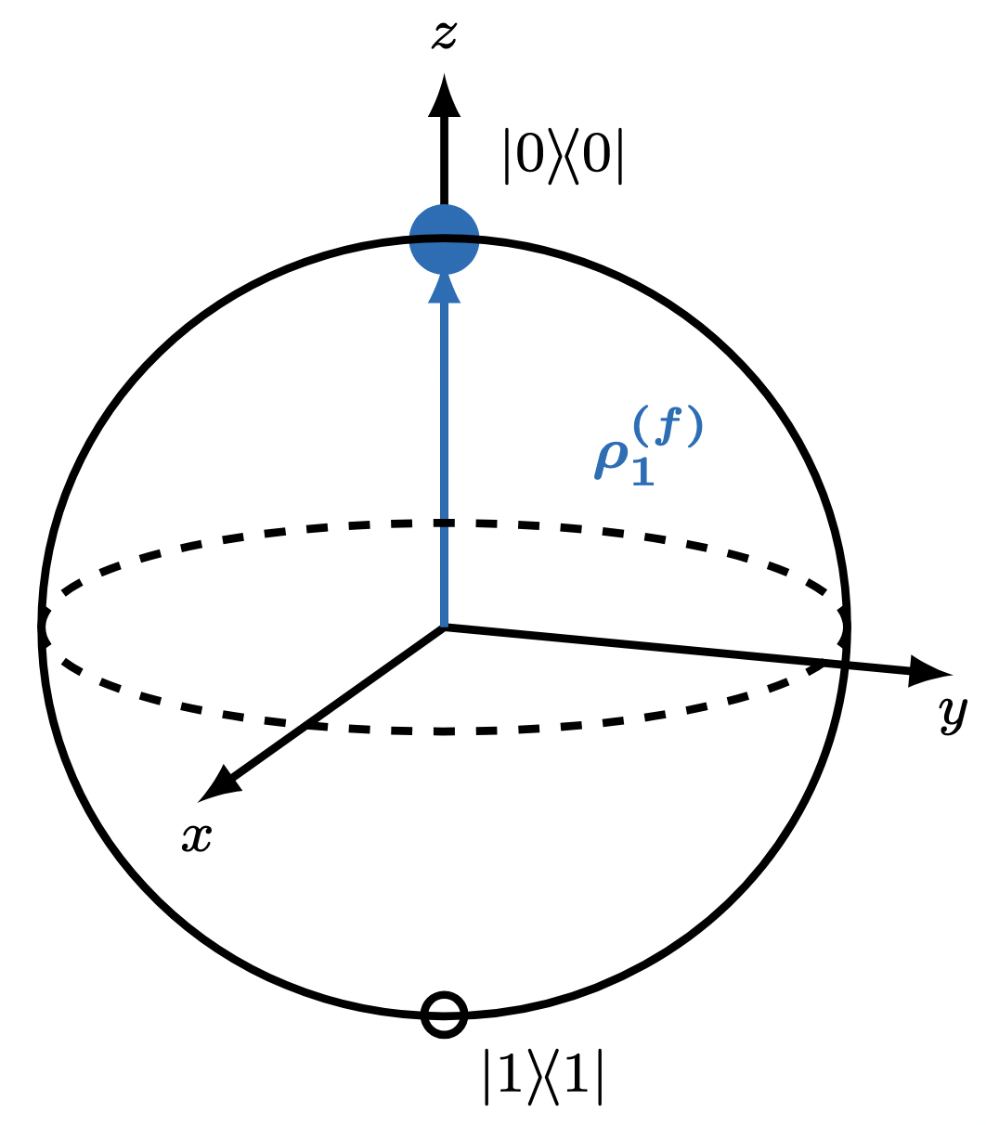
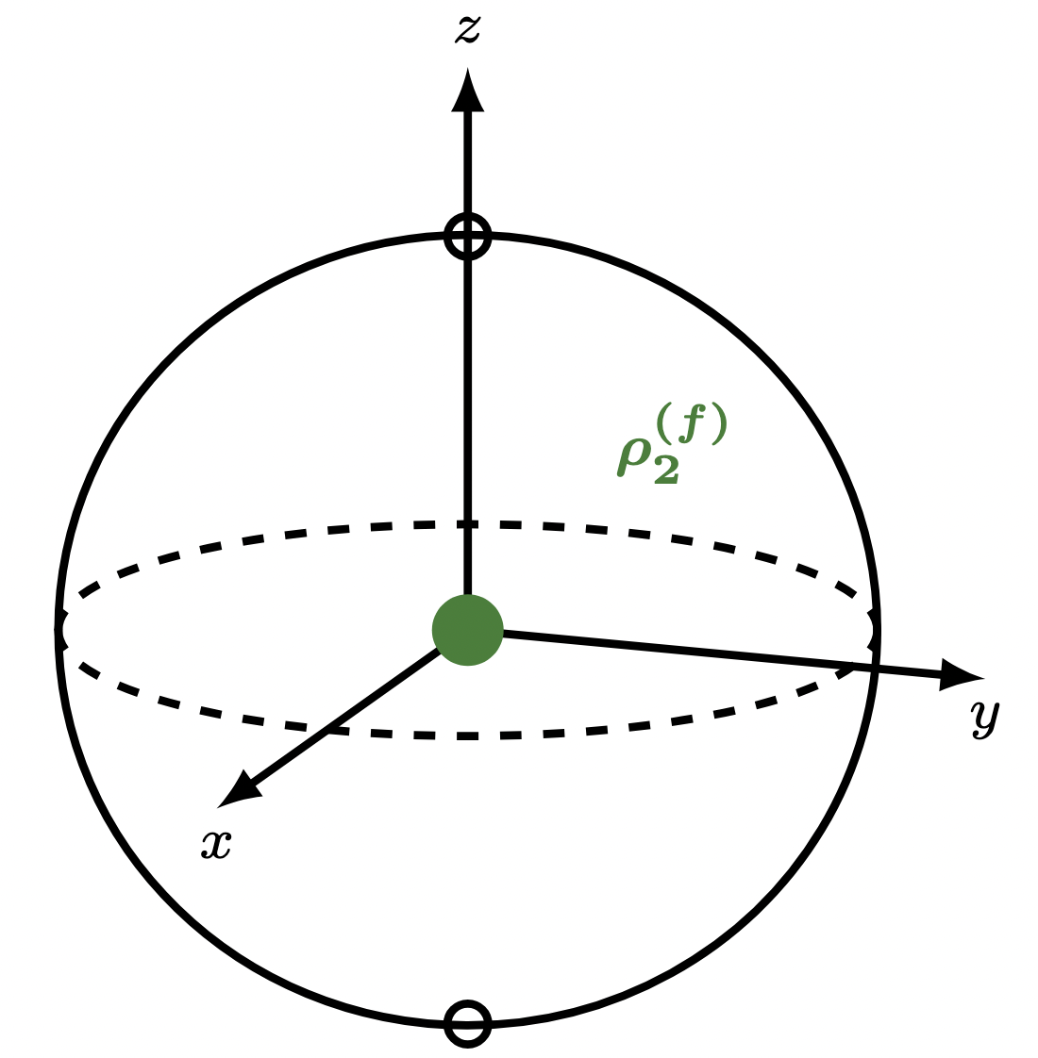
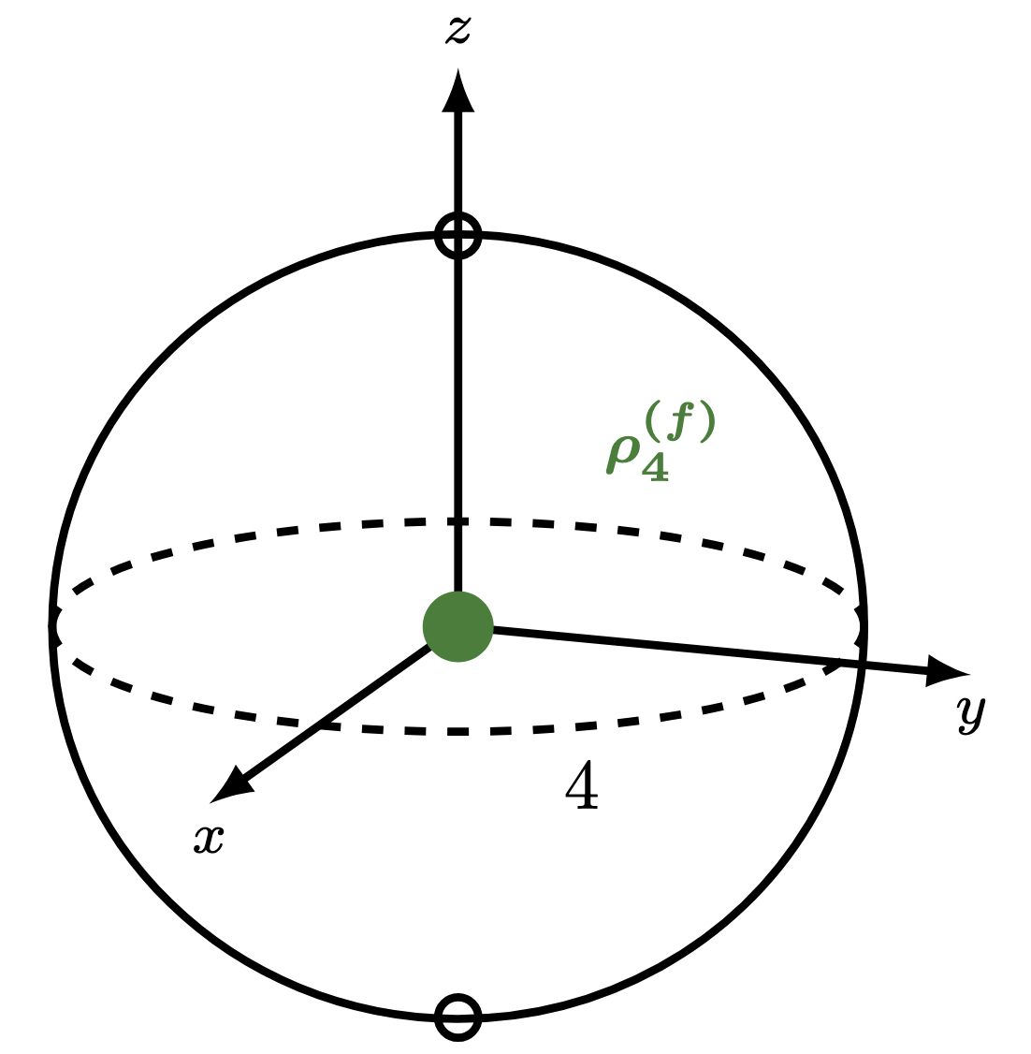
Quasi-classical Tensor Product Structure (qcTPS)
time evolution
8
Notes:
– Potato
– We see the potato as in a single position? Why?
– Let’s treat, for example, the potato as a quantum object in a superposition of
position 1 and position 2
- system tensor product environment is what it means to be unentangled

Slide 50
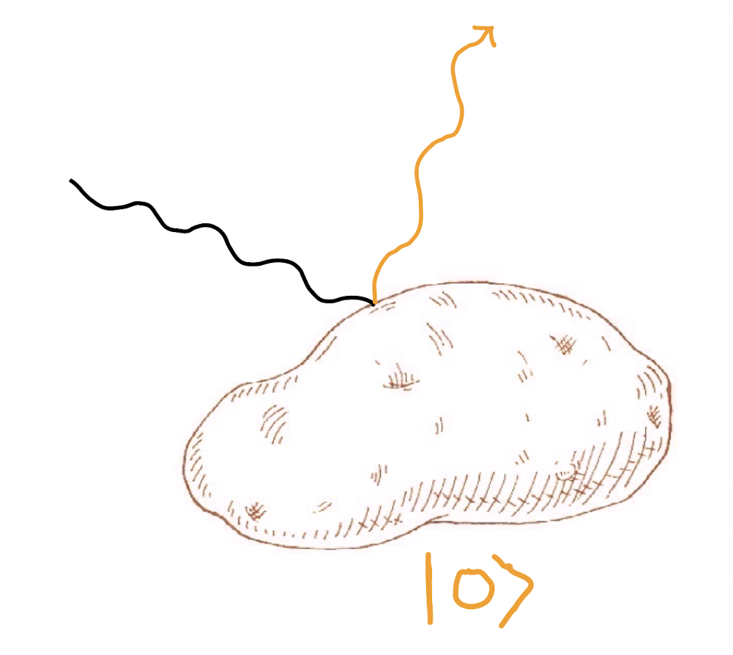
Quasi-classical Tensor Product Structure (qcTPS)
time evolution
8
Notes:
– Potato
– We see the potato as in a single position? Why?
– Let’s treat, for example, the potato as a quantum object in a superposition of
position 1 and position 2
- system tensor product environment is what it means to be unentangled

Slide 51
Quasi-classical Tensor Product Structure (qcTPS)
time evolution
qcTPSs have well-defined pointer states!
8
Notes:
– Potato
– We see the potato as in a single position? Why?
– Let’s treat, for example, the potato as a quantum object in a superposition of
position 1 and position 2
- system tensor product environment is what it means to be unentangled

Slide 52
Tensor Product Structures
Tensor Product Structure 1 (Qubits 1, 2, 3):
Tensor Product Structure 2 (Qubits 1′ , 2′, 3′):
9
Notes:
– Potato
– We see the potato as in a single position? Why?
– Let’s treat, for example, the potato as a quantum object in a superposition of
position 1 and position 2
- system tensor product environment is what it means to be unentangled

Slide 53
Tensor Product Structures
Tensor Product Structure 1 (Qubits 1, 2, 3):
Tensor Product Structure 2 (Qubits 1′ , 2′, 3′):
9
Notes:
– Potato
– We see the potato as in a single position? Why?
– Let’s treat, for example, the potato as a quantum object in a superposition of
position 1 and position 2
- system tensor product environment is what it means to be unentangled

Slide 54
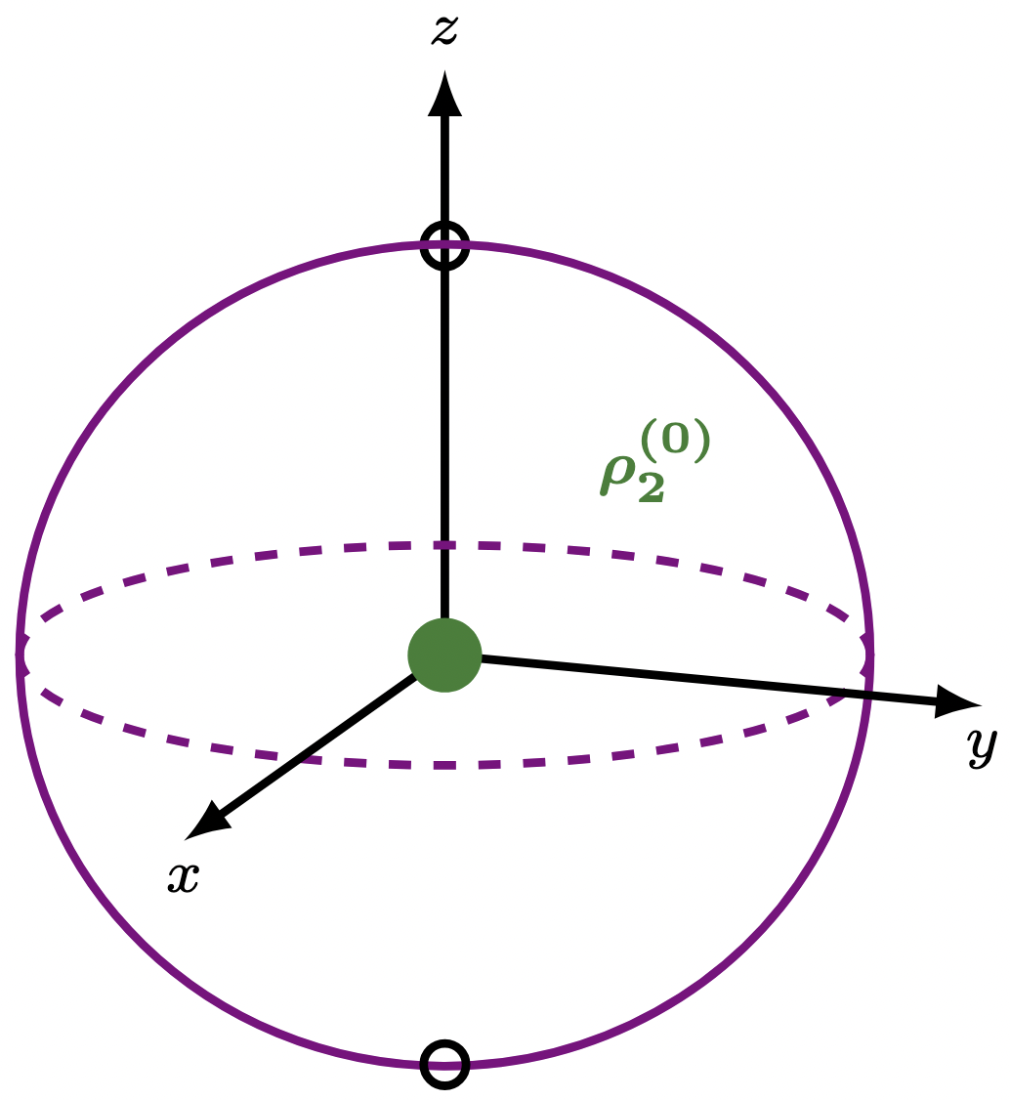
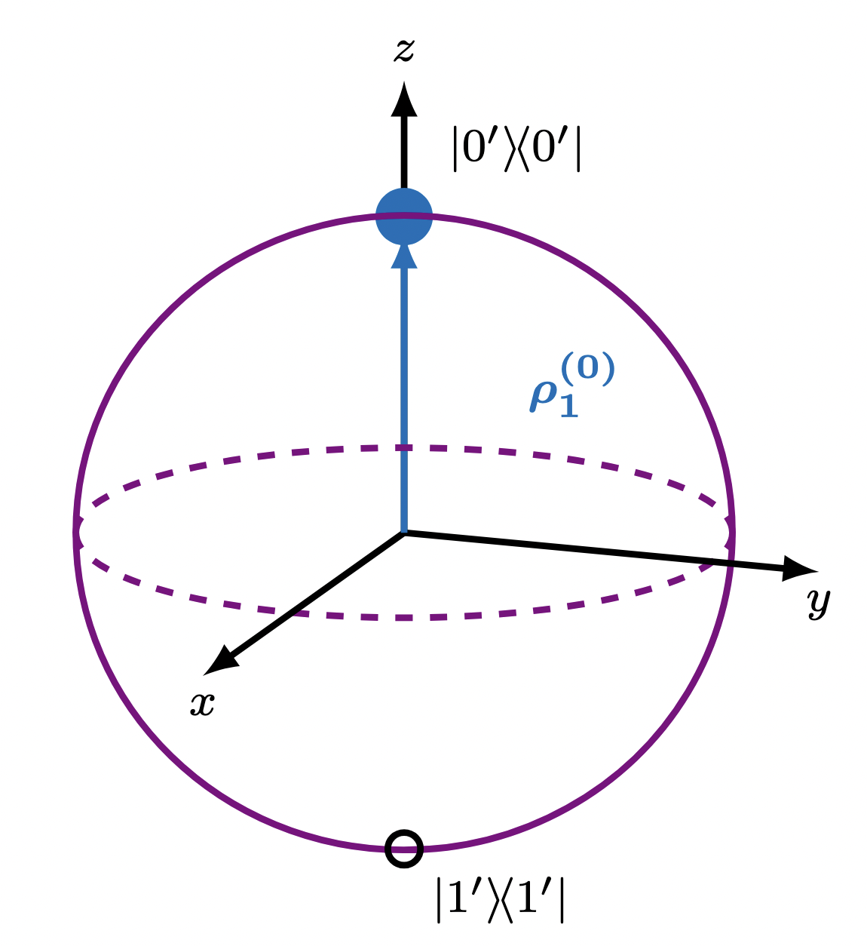
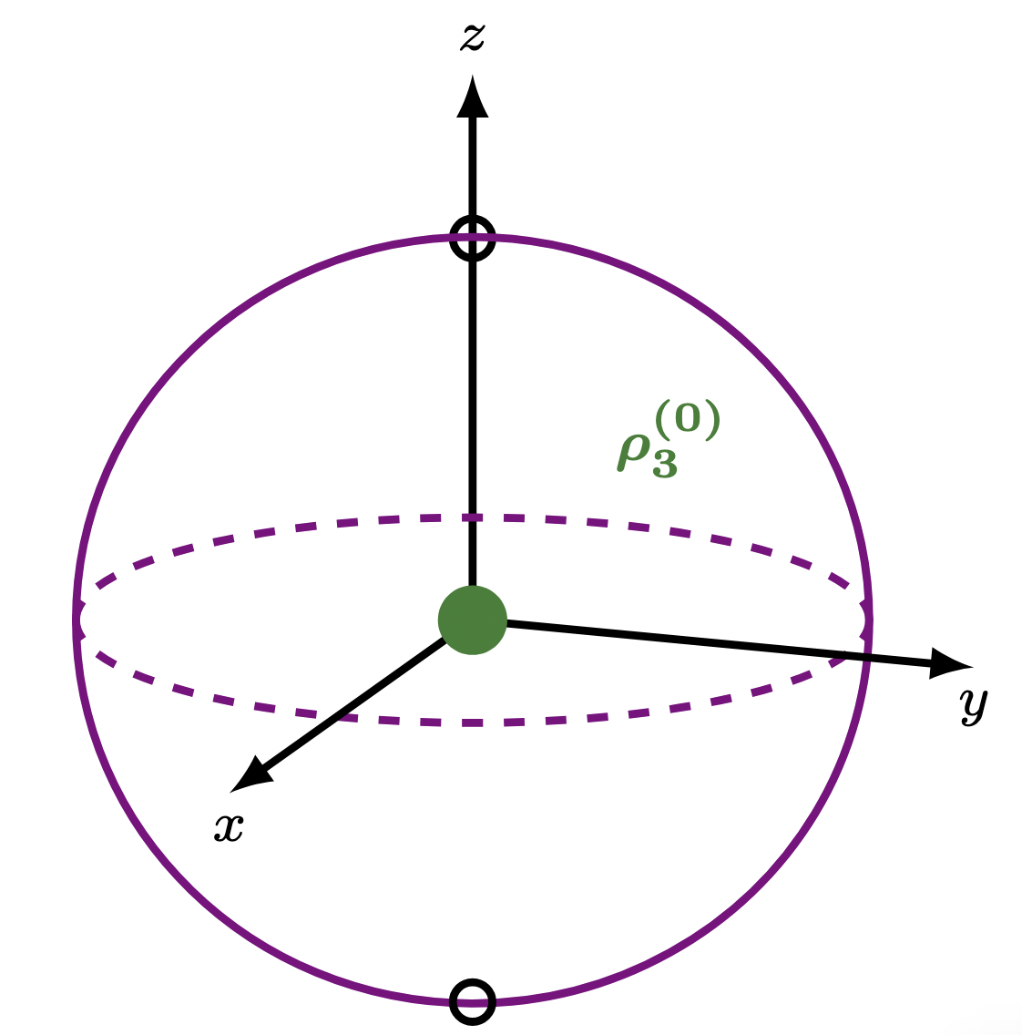
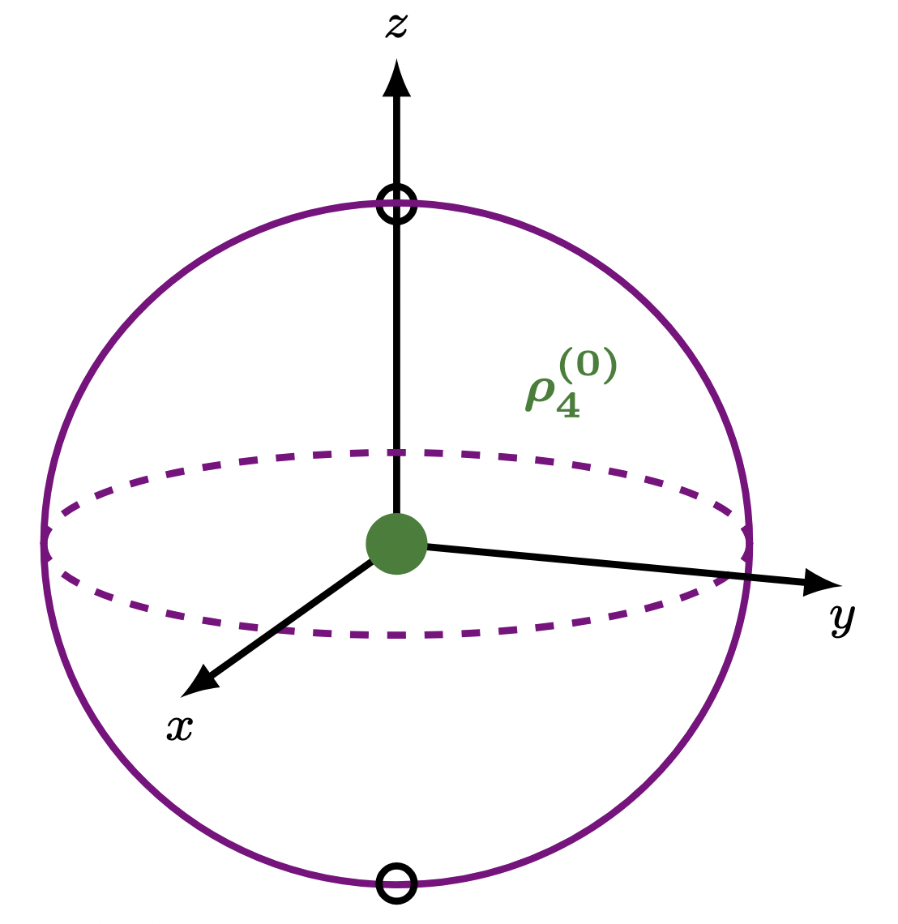
Generic Tensor Product Structure
10
Notes:
– Potato
– We see the potato as in a single position? Why?
– Let’s treat, for example, the potato as a quantum object in a superposition of
position 1 and position 2
- system tensor product environment is what it means to be unentangled

Slide 55
Generic Tensor Product Structure
time evolution
10
Notes:
– Potato
– We see the potato as in a single position? Why?
– Let’s treat, for example, the potato as a quantum object in a superposition of
position 1 and position 2
- system tensor product environment is what it means to be unentangled

Slide 56
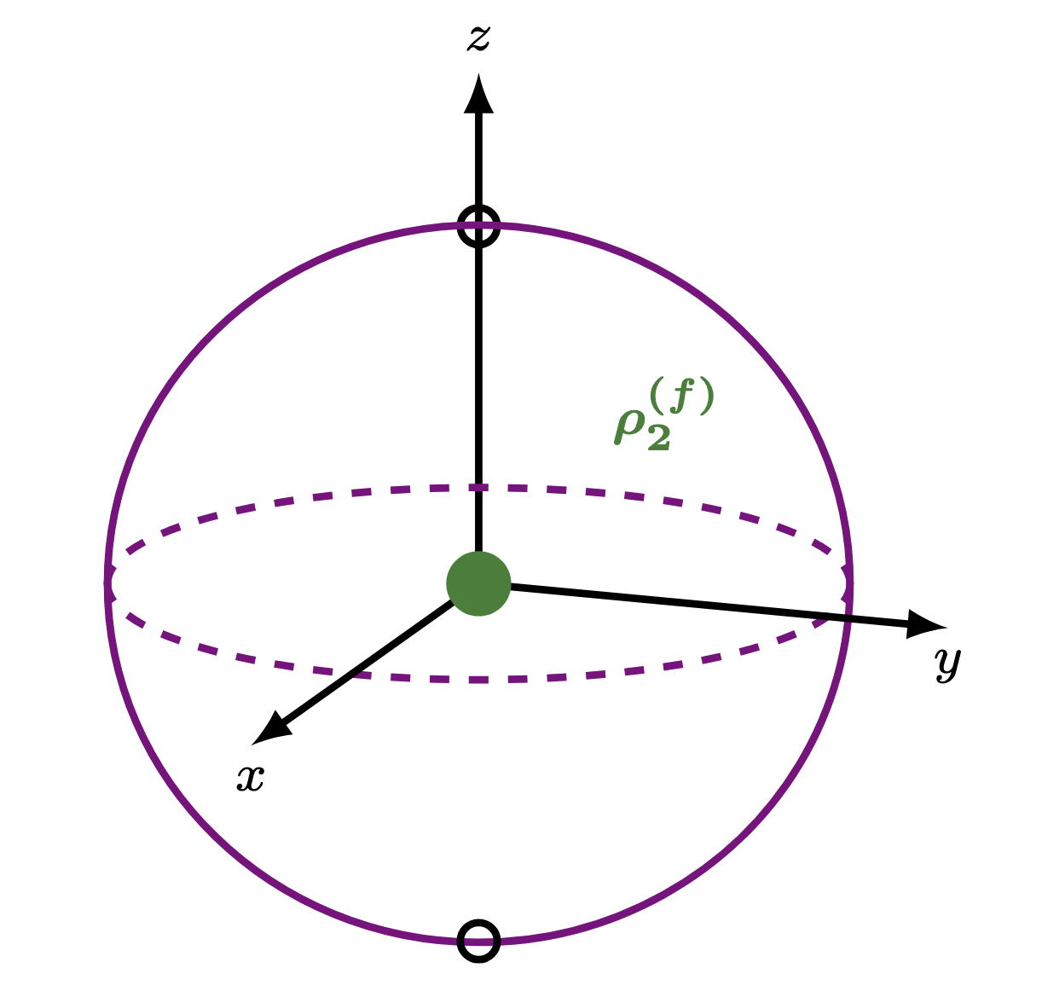
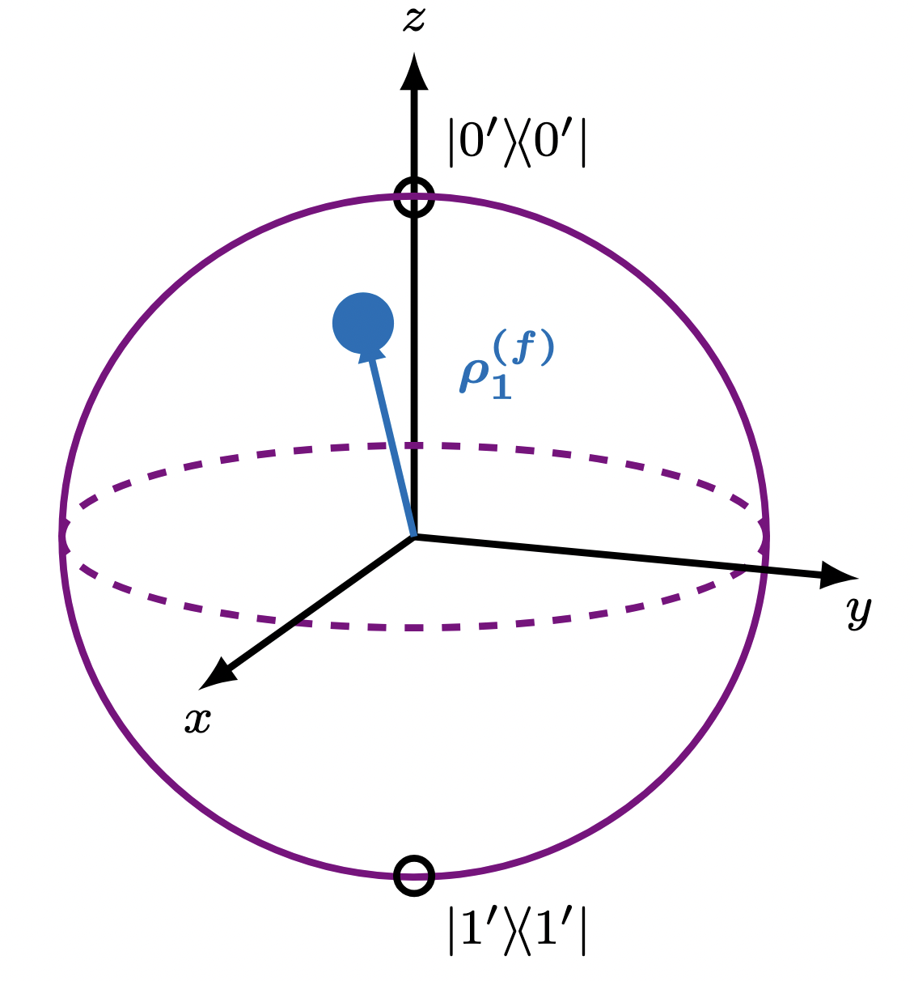
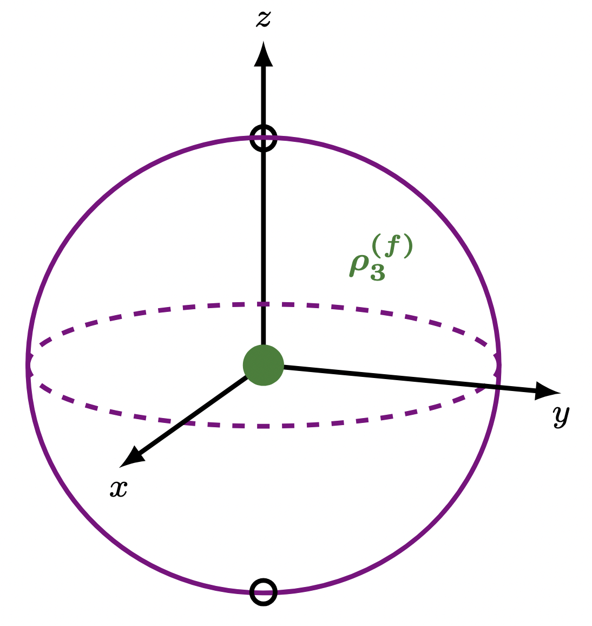
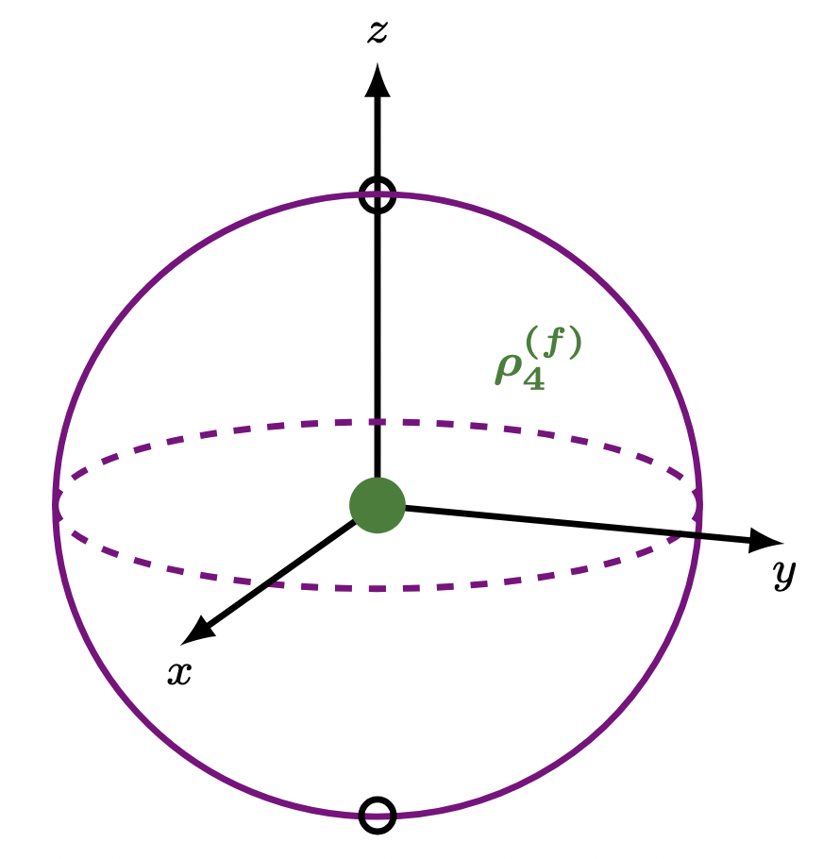
Generic Tensor Product Structure
time evolution
10
Notes:
– Potato
– We see the potato as in a single position? Why?
– Let’s treat, for example, the potato as a quantum object in a superposition of
position 1 and position 2
- system tensor product environment is what it means to be unentangled

Slide 57
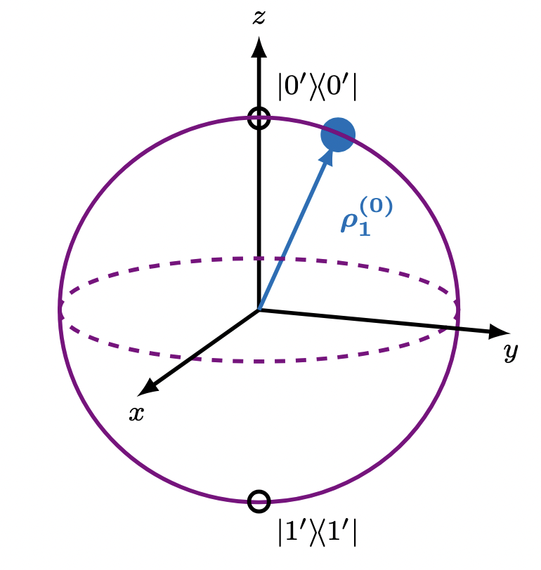
Generic Tensor Product Structure
10
Notes:
– Potato
– We see the potato as in a single position? Why?
– Let’s treat, for example, the potato as a quantum object in a superposition of
position 1 and position 2
- system tensor product environment is what it means to be unentangled

Slide 58
Generic Tensor Product Structure
time evolution
10
Notes:
– Potato
– We see the potato as in a single position? Why?
– Let’s treat, for example, the potato as a quantum object in a superposition of
position 1 and position 2
- system tensor product environment is what it means to be unentangled

Slide 59
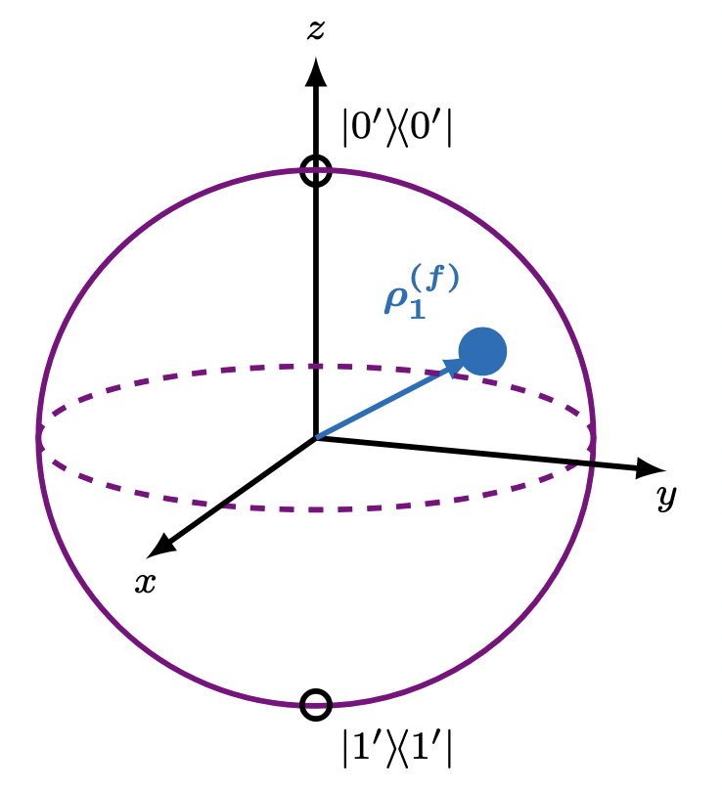
Generic Tensor Product Structure
time evolution
10
Notes:
– Potato
– We see the potato as in a single position? Why?
– Let’s treat, for example, the potato as a quantum object in a superposition of
position 1 and position 2
- system tensor product environment is what it means to be unentangled

Slide 60
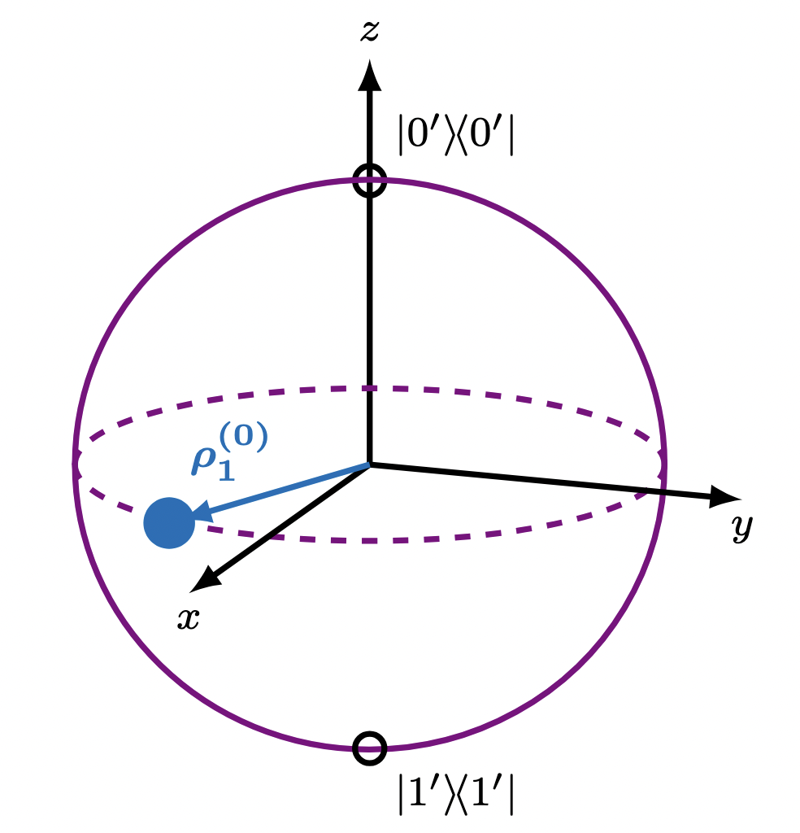
Generic Tensor Product Structure
10
Notes:
– Potato
– We see the potato as in a single position? Why?
– Let’s treat, for example, the potato as a quantum object in a superposition of
position 1 and position 2
- system tensor product environment is what it means to be unentangled

Slide 61
Generic Tensor Product Structure
time evolution
10
Notes:
– Potato
– We see the potato as in a single position? Why?
– Let’s treat, for example, the potato as a quantum object in a superposition of
position 1 and position 2
- system tensor product environment is what it means to be unentangled

Slide 62
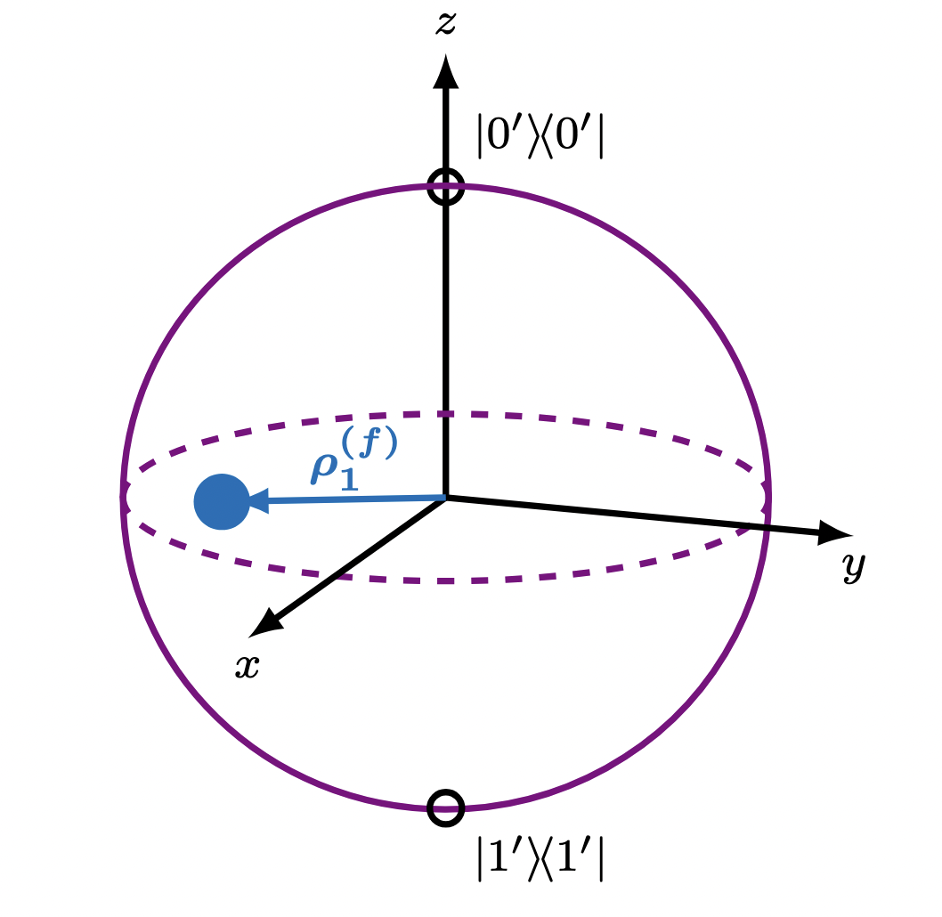
Generic Tensor Product Structure
time evolution
10
Notes:
– Potato
– We see the potato as in a single position? Why?
– Let’s treat, for example, the potato as a quantum object in a superposition of
position 1 and position 2
- system tensor product environment is what it means to be unentangled

Slide 63
Generic Tensor Product Structure
time evolution
In general, a TPS has no well-defined pointer state
10
Notes:
– Potato
– We see the potato as in a single position? Why?
– Let’s treat, for example, the potato as a quantum object in a superposition of
position 1 and position 2
- system tensor product environment is what it means to be unentangled

Slide 64
How to Determine the Preferred Division into Subsystems?
Require that a valid TPS can exhibit quasi-classical dynamics (has a well-defined pointer state)
Metrics:
  Predictability
  Robustness
Carroll and Singh [1]: Both metrics are required
  [1] S. M. Carroll and A. Singh, “Quantum Mereology: Factorizing Hilbert Space into Subsystems with Quasi-Classical Dynamics,”
11
Notes:
– Potato
– We see the potato as in a single position? Why?
– Let’s treat, for example, the potato as a quantum object in a superposition of
position 1 and position 2
- system tensor product environment is what it means to be unentangled

Slide 65
Primary Guiding Question of Thesis:
What is the relationship between the metrics of “predictability” and “robustness”?
Method:
Use a machine learning algorithm to search the space of all possible TPSs to find qcTPSs according to each metric.
12
Notes:
– Potato
– We see the potato as in a single position? Why?
– Let’s treat, for example, the potato as a quantum object in a superposition of
position 1 and position 2
- system tensor product environment is what it means to be unentangled

Slide 66
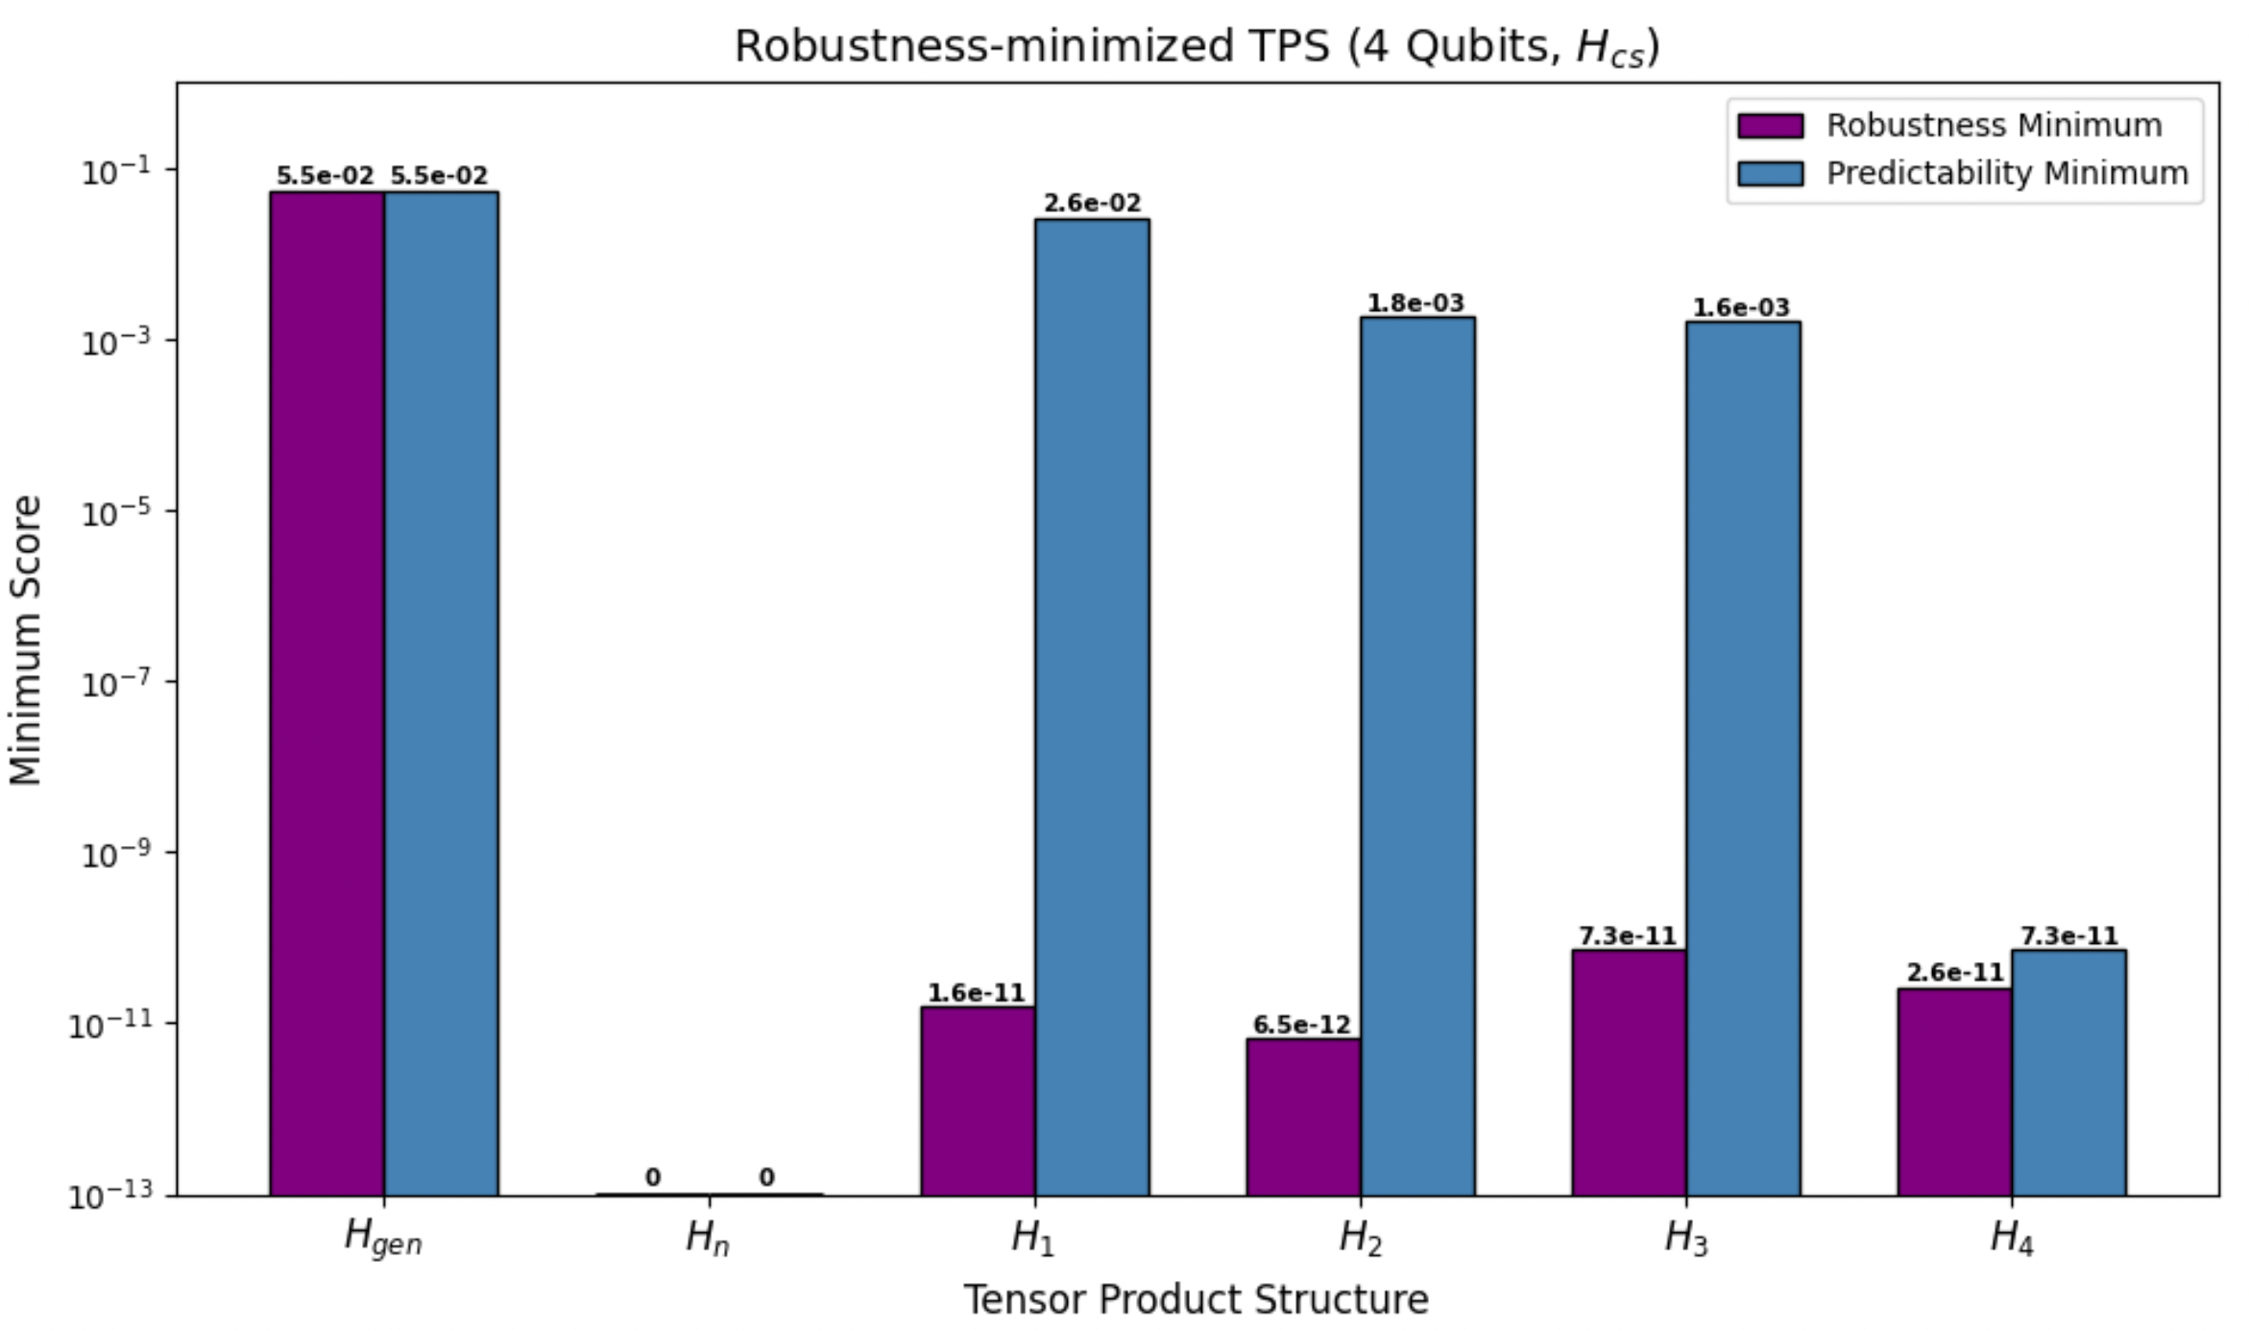
Results: Predictability Implies Robustness
13
Notes:
Entanglement—can’t think of the potato and the photon separately anymore (e.g., unknown relative phase)
Photon and potato have “lost inidividuality”
“Coherence” has become delocalized to the level of the potato-photon (to make a predictable measurement)
Relative to split of system and environment
Consider if additional environmental photons were to interact with the potato. Then, rapid generation of entanglement.
This rapid generation entanglement becomes unstable -> decoherence
Decohere to a pointer state

Slide 67
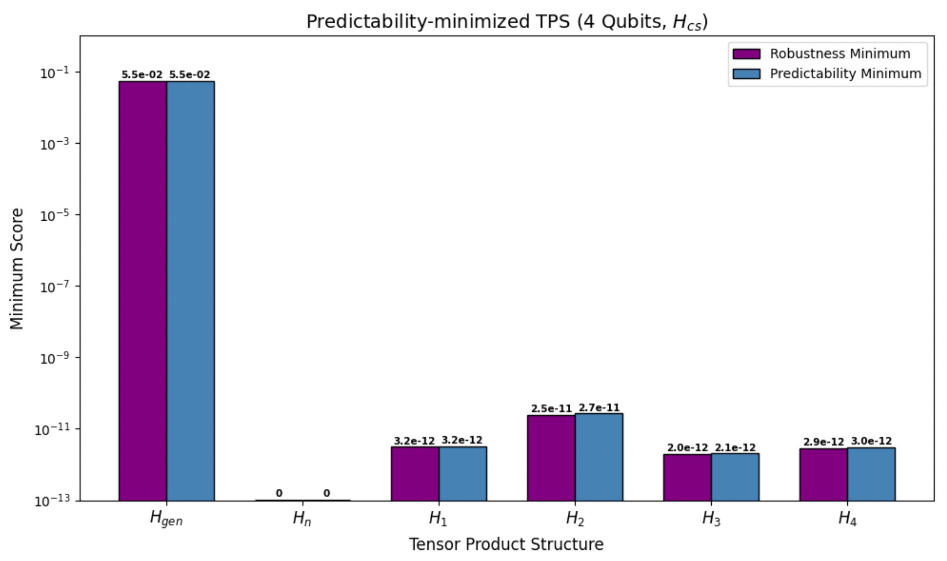
Results: Predictability Implies Robustness
13
Notes:
Entanglement—can’t think of the potato and the photon separately anymore (e.g., unknown relative phase)
Photon and potato have “lost inidividuality”
“Coherence” has become delocalized to the level of the potato-photon (to make a predictable measurement)
Relative to split of system and environment
Consider if additional environmental photons were to interact with the potato. Then, rapid generation of entanglement.
This rapid generation entanglement becomes unstable -> decoherence
Decohere to a pointer state

Slide 68
Results: Predictability Implies Robustness
13
Notes:
Entanglement—can’t think of the potato and the photon separately anymore (e.g., unknown relative phase)
Photon and potato have “lost inidividuality”
“Coherence” has become delocalized to the level of the potato-photon (to make a predictable measurement)
Relative to split of system and environment
Consider if additional environmental photons were to interact with the potato. Then, rapid generation of entanglement.
This rapid generation entanglement becomes unstable -> decoherence
Decohere to a pointer state

Slide 69
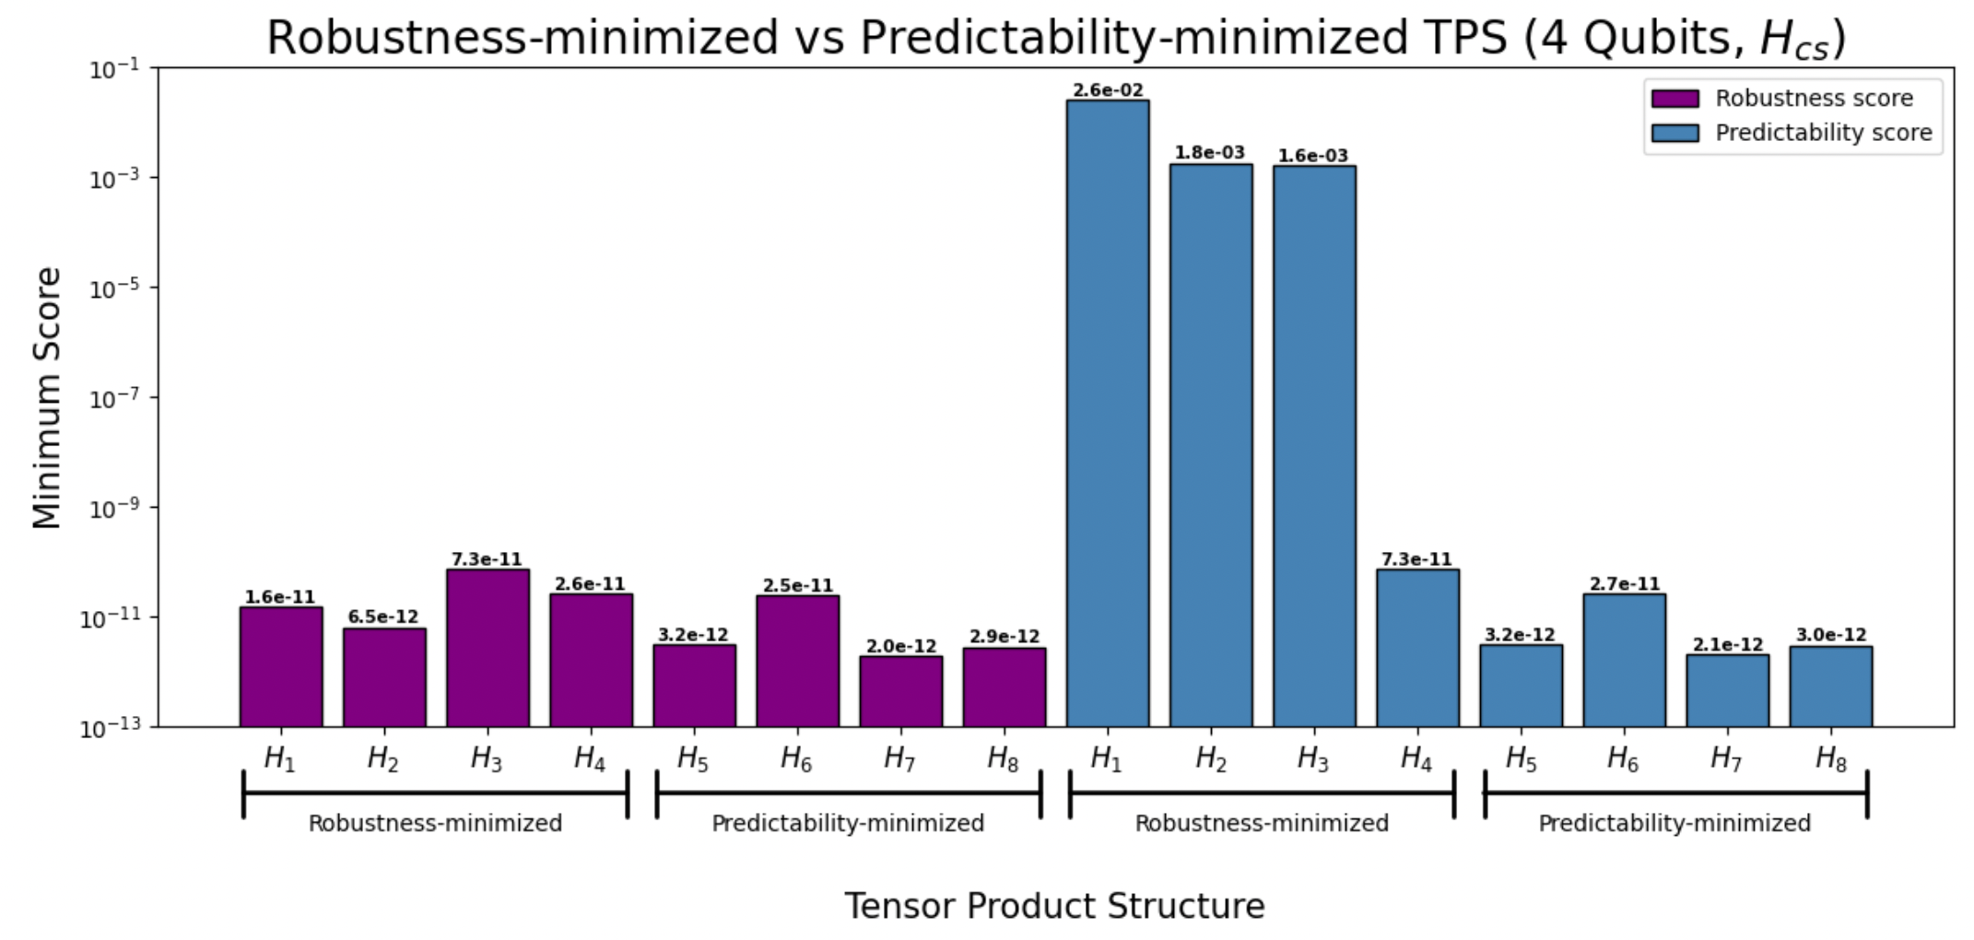
Results: Predictability Implies Robustness
13
Notes:
Entanglement—can’t think of the potato and the photon separately anymore (e.g., unknown relative phase)
Photon and potato have “lost inidividuality”
“Coherence” has become delocalized to the level of the potato-photon (to make a predictable measurement)
Relative to split of system and environment
Consider if additional environmental photons were to interact with the potato. Then, rapid generation of entanglement.
This rapid generation entanglement becomes unstable -> decoherence
Decohere to a pointer state

Slide 70
Conclusions
Predictability implies robustness.
14

Slide 71
Conclusions
Predictability implies robustness. In particular, a TPS with a minimal predictability score must also have a minimal robustness score.
14

Slide 72
Conclusions
Predictability implies robustness. In particular, a TPS with a minimal predictability score must also have a minimal robustness score.
Quasi-classical TPSs exhibit a significantly higher variance of scores across their initial states than a generic TPS.
14

Slide 73
Gratitude
Prof. Setter for all of the time he’s spent talking with me about quantum and his incredible guidance
Dwight, Prof. Moore, and the rest of the Pomona Physics Department for their unwavering support both throughout this thesis and my time at Pomona
  Also Dwight for pushing me to attempt an explanation of my thesis without any equations
All of the context in my life that has provided me with the privileged opportunity to study physics at Pomona College
The indeterminacy of quantum mechanics for deeply connecting me to the universe
Notes:
Entanglement—can’t think of the potato and the photon separately anymore (e.g., unknown relative phase)
Photon and potato have “lost inidividuality”
“Coherence” has become delocalized to the level of the potato-photon (to make a predictable measurement)
Relative to split of system and environment
Consider if additional environmental photons were to interact with the potato. Then, rapid generation of entanglement.
This rapid generation entanglement becomes unstable -> decoherence
Decohere to a pointer state

Slide 74
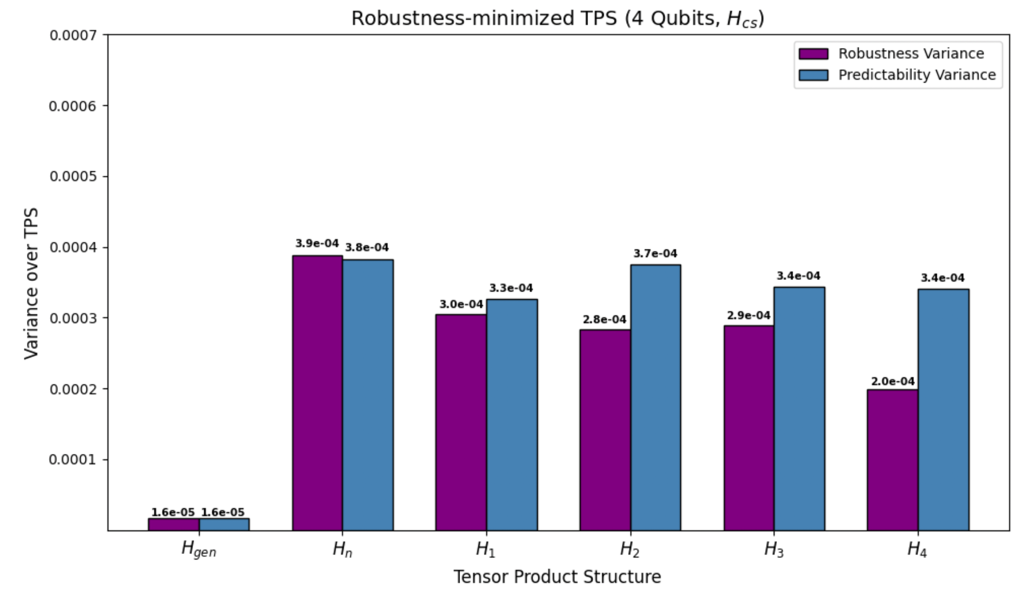
Results: Variance Greater for qcTPS
Notes:
Entanglement—can’t think of the potato and the photon separately anymore (e.g., unknown relative phase)
Photon and potato have “lost inidividuality”
“Coherence” has become delocalized to the level of the potato-photon (to make a predictable measurement)
Relative to split of system and environment
Consider if additional environmental photons were to interact with the potato. Then, rapid generation of entanglement.
This rapid generation entanglement becomes unstable -> decoherence
Decohere to a pointer state

Slide 75
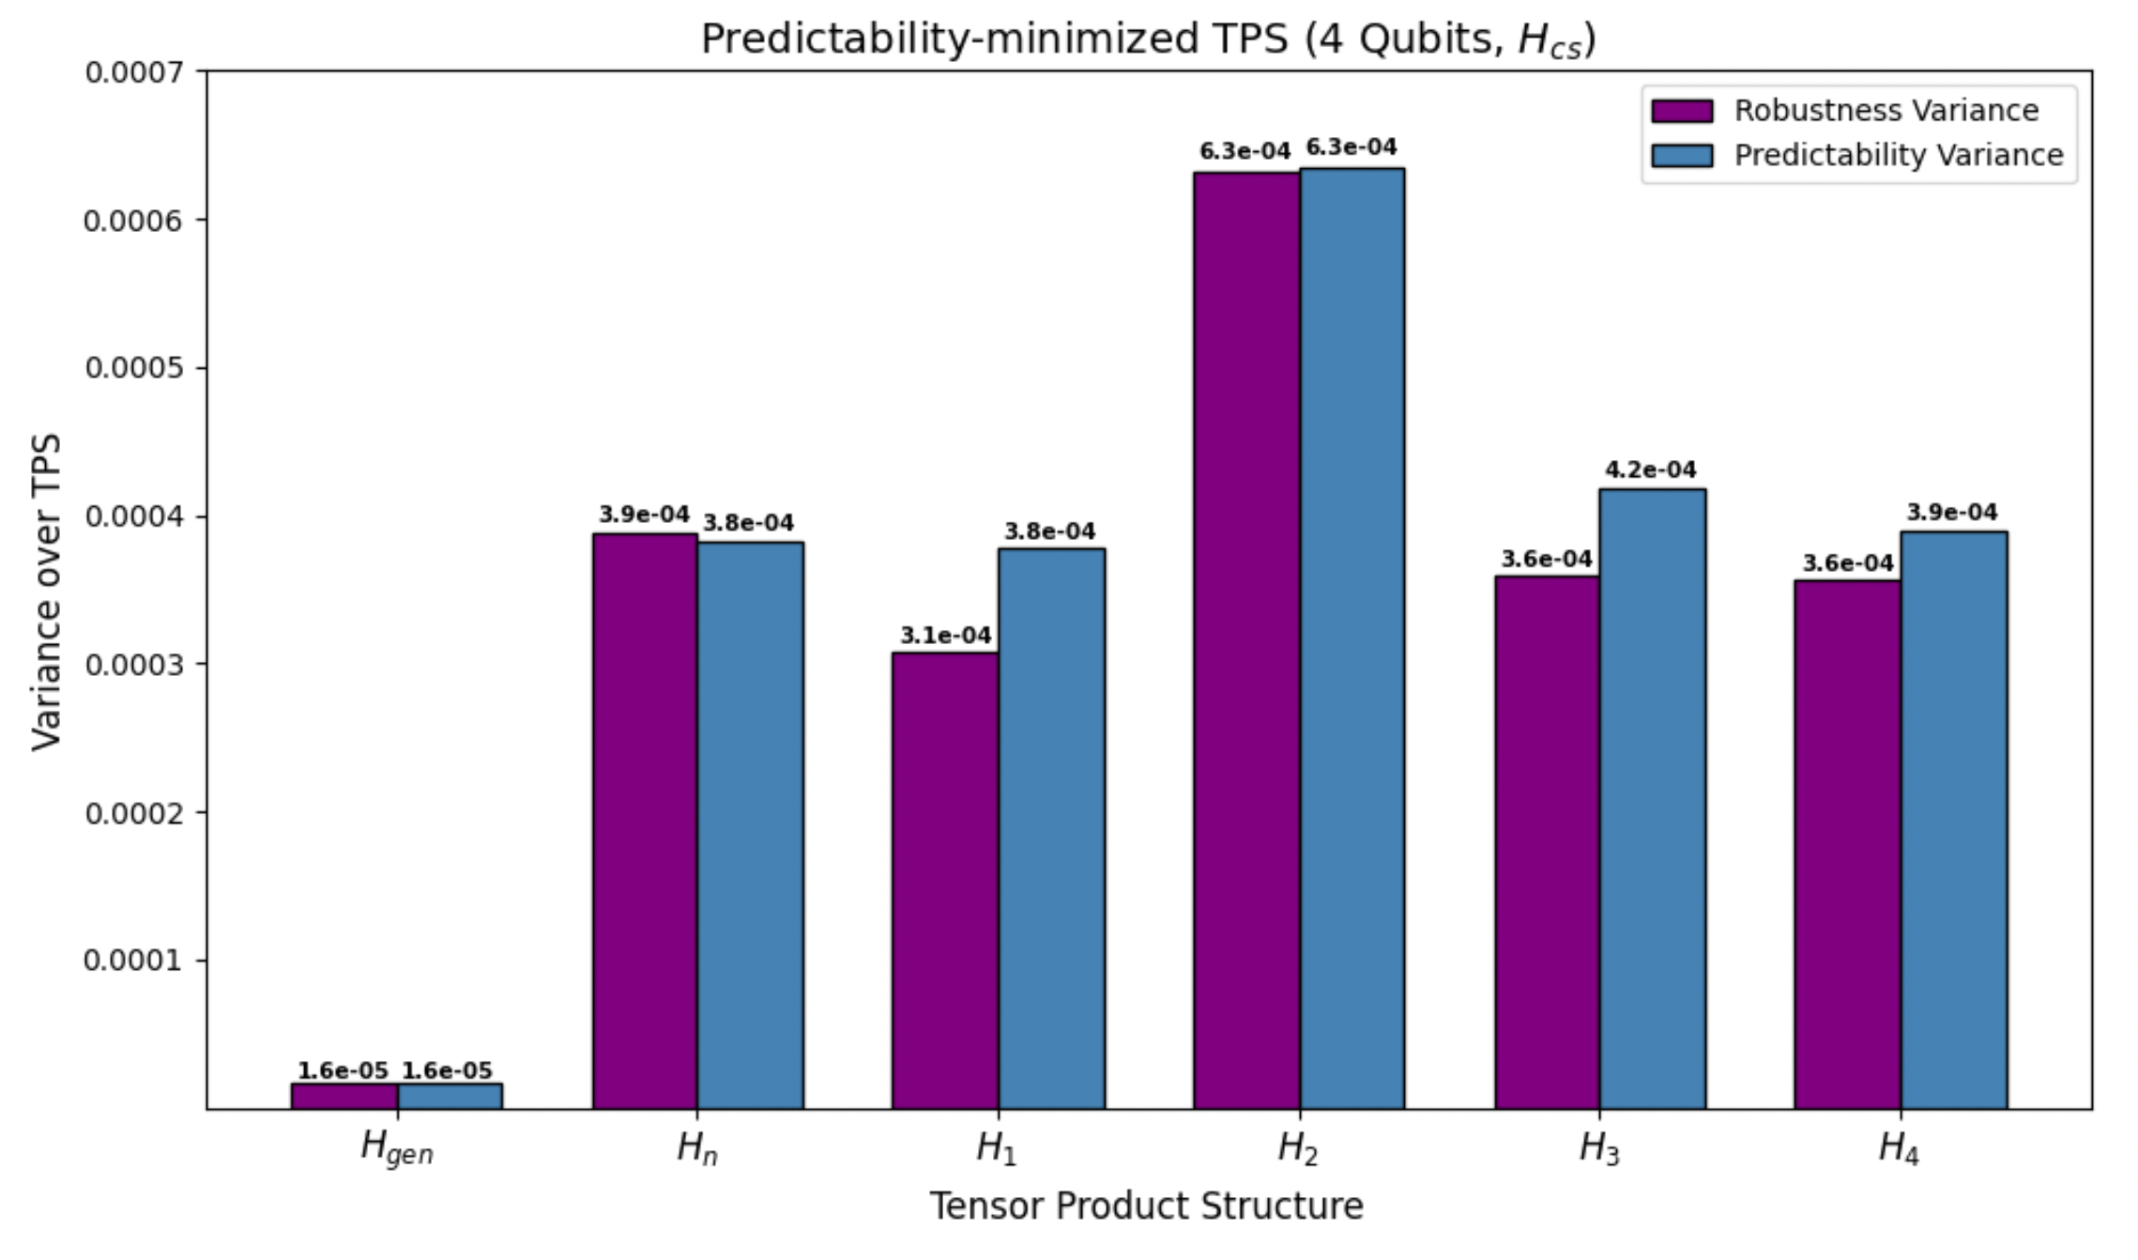
Results: Variance Greater for qcTPS
Notes:
Entanglement—can’t think of the potato and the photon separately anymore (e.g., unknown relative phase)
Photon and potato have “lost inidividuality”
“Coherence” has become delocalized to the level of the potato-photon (to make a predictable measurement)
Relative to split of system and environment
Consider if additional environmental photons were to interact with the potato. Then, rapid generation of entanglement.
This rapid generation entanglement becomes unstable -> decoherence
Decohere to a pointer state

Slide 76
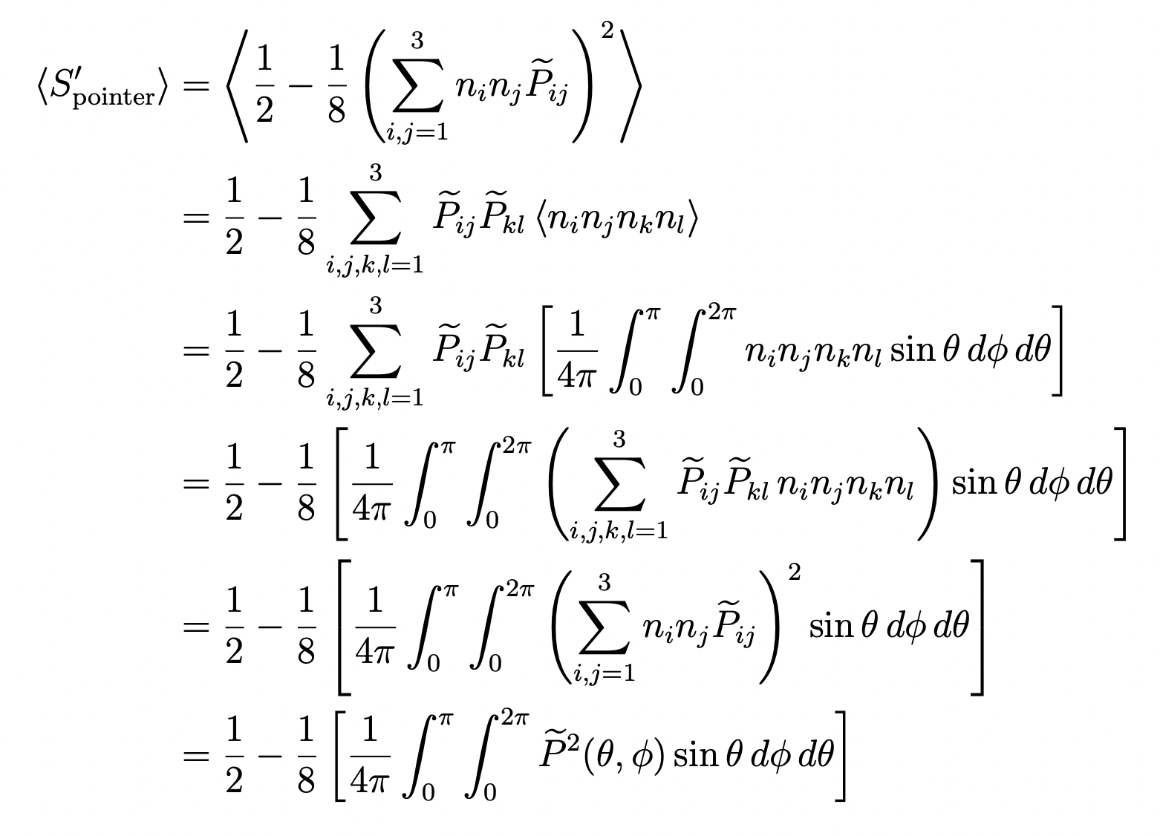
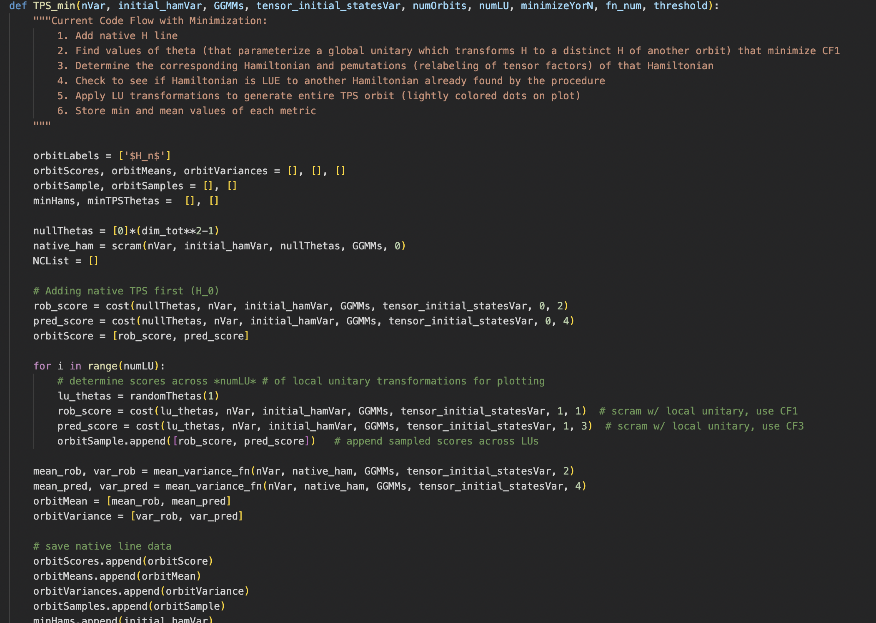
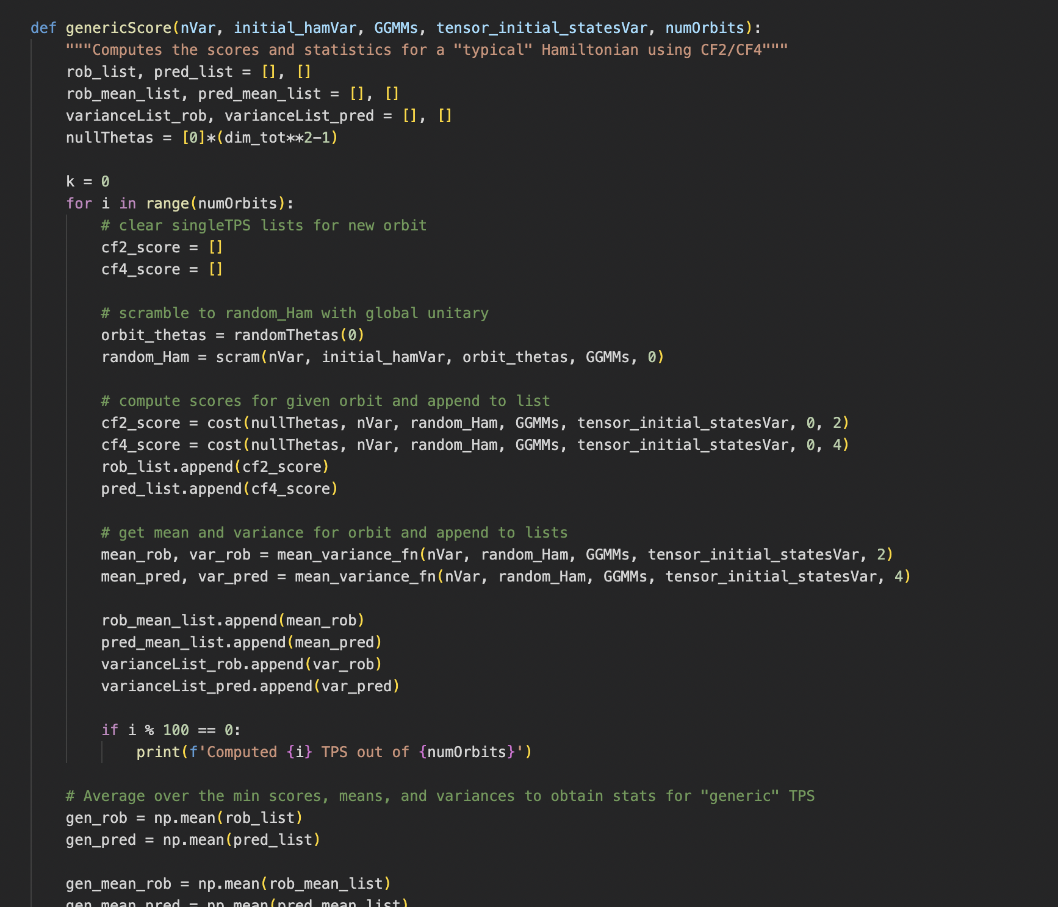


What Did I Actually Do?
Notes:
Entanglement—can’t think of the potato and the photon separately anymore (e.g., unknown relative phase)
Photon and potato have “lost inidividuality”
“Coherence” has become delocalized to the level of the potato-photon (to make a predictable measurement)
Relative to split of system and environment
Consider if additional environmental photons were to interact with the potato. Then, rapid generation of entanglement.
This rapid generation entanglement becomes unstable -> decoherence
Decohere to a pointer state

Slide 77



Predictability and Robustness
Notes:
Entanglement—can’t think of the potato and the photon separately anymore (e.g., unknown relative phase)
Photon and potato have “lost inidividuality”
“Coherence” has become delocalized to the level of the potato-photon (to make a predictable measurement)
Relative to split of system and environment
Consider if additional environmental photons were to interact with the potato. Then, rapid generation of entanglement.
This rapid generation entanglement becomes unstable -> decoherence
Decohere to a pointer state

